Slide 1
Sample or FOC Invoice PPT

Slide 2
Sample Invoices , FOC Invoices are made for various purposes.
Example :-
1. A Corrugator is Sending one box as sample to the customer.
2. A Plastic Component Maker sends a Washing Machine Tub as Sample for Approval to Samsung / LG Electronics
3. A Water Pump manufacturer is Sending a material for replacement to a customer, a small part is being sent to the customer.
4. You are a seller of the Packaging machine and a small nut has gone loose so you are replacing a nut and so on.
5. My buyer wants 2 pc for Displaying in his Showroom as sample. and I am ready to give it Free of Cost ( FOC )

Slide 3
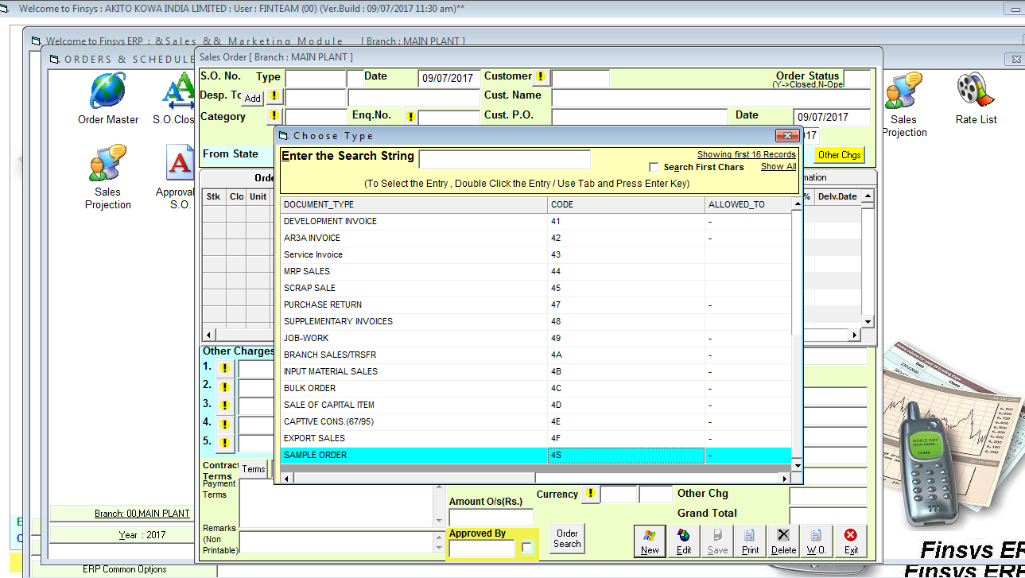
Select the Sales Order Type = 4S

Slide 4
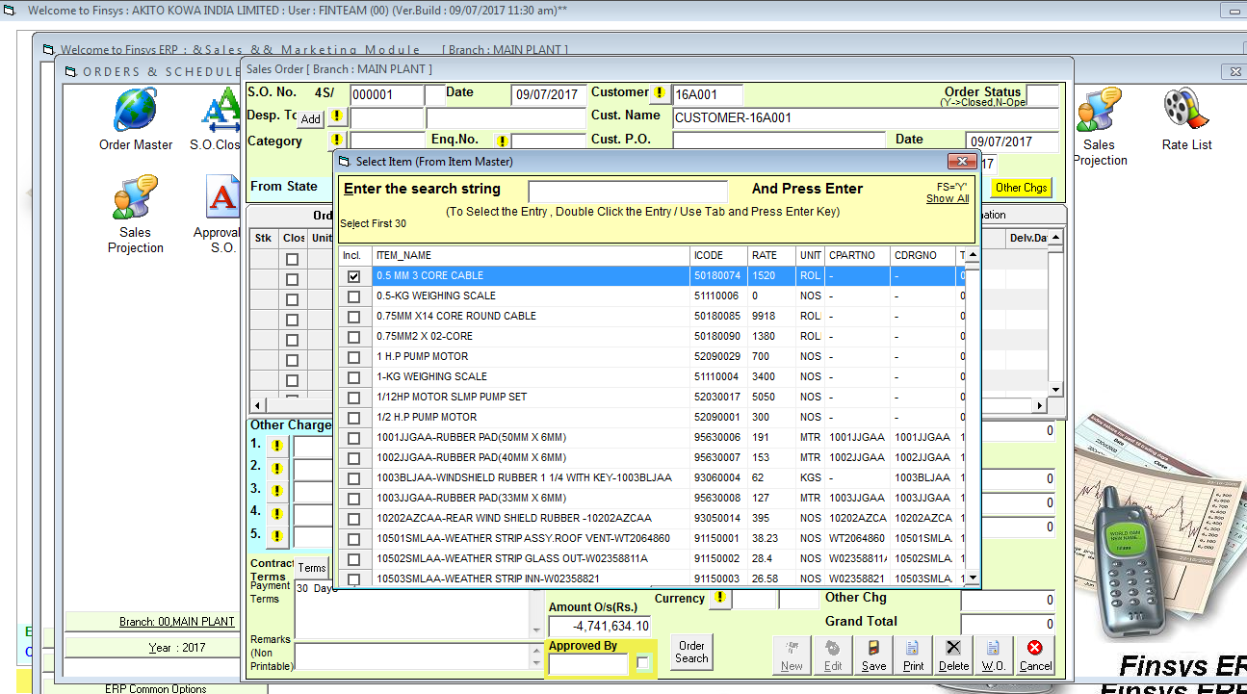
Select Customer

Slide 5
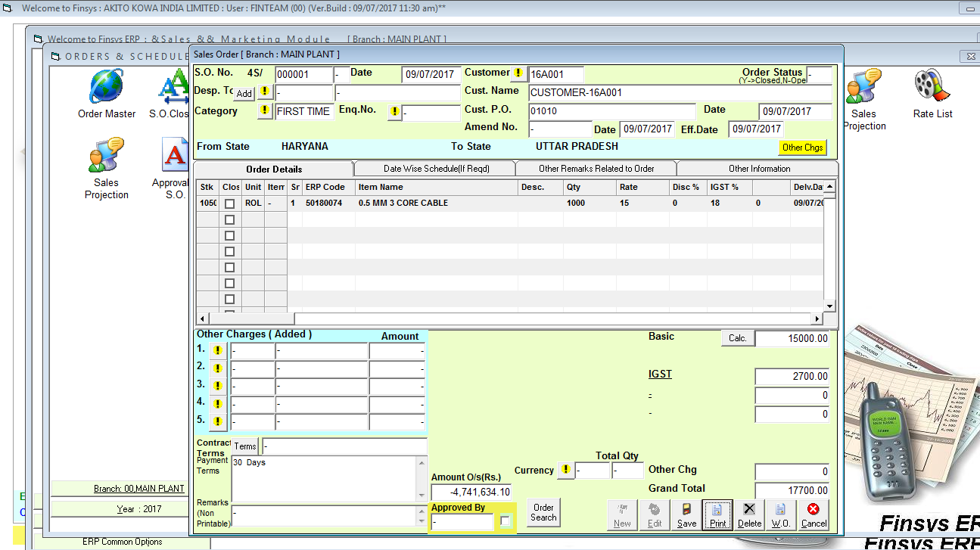
Sales order screen

Slide 6
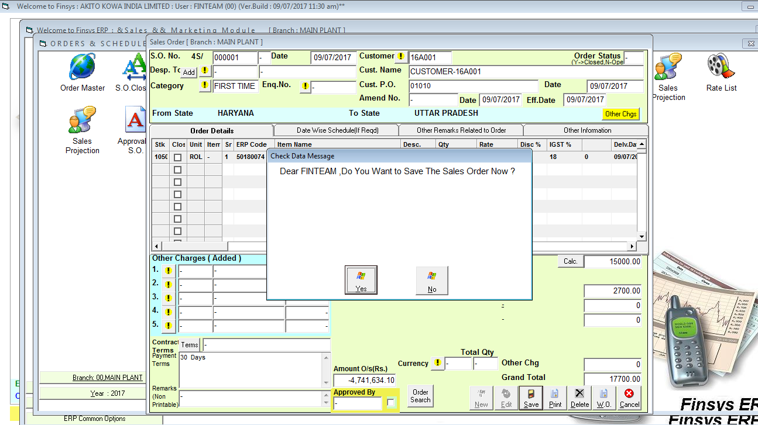
Asking for save of the S.O.

Slide 7
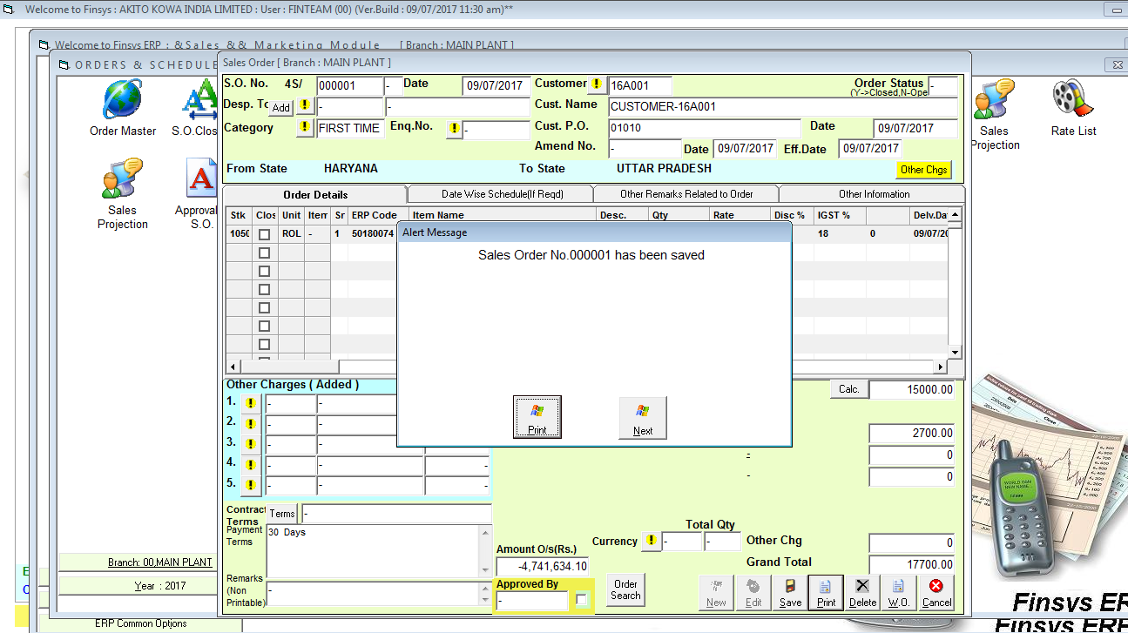
S.O. is saved with a no. 000001

Slide 8
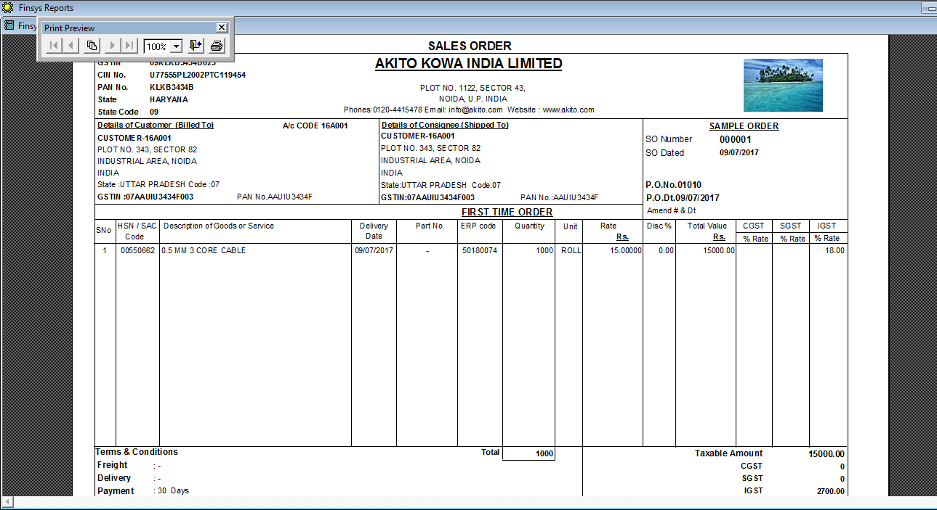
Print Out of S.O.

Slide 9
Next ....
How to create Sample Invoice

Slide 10
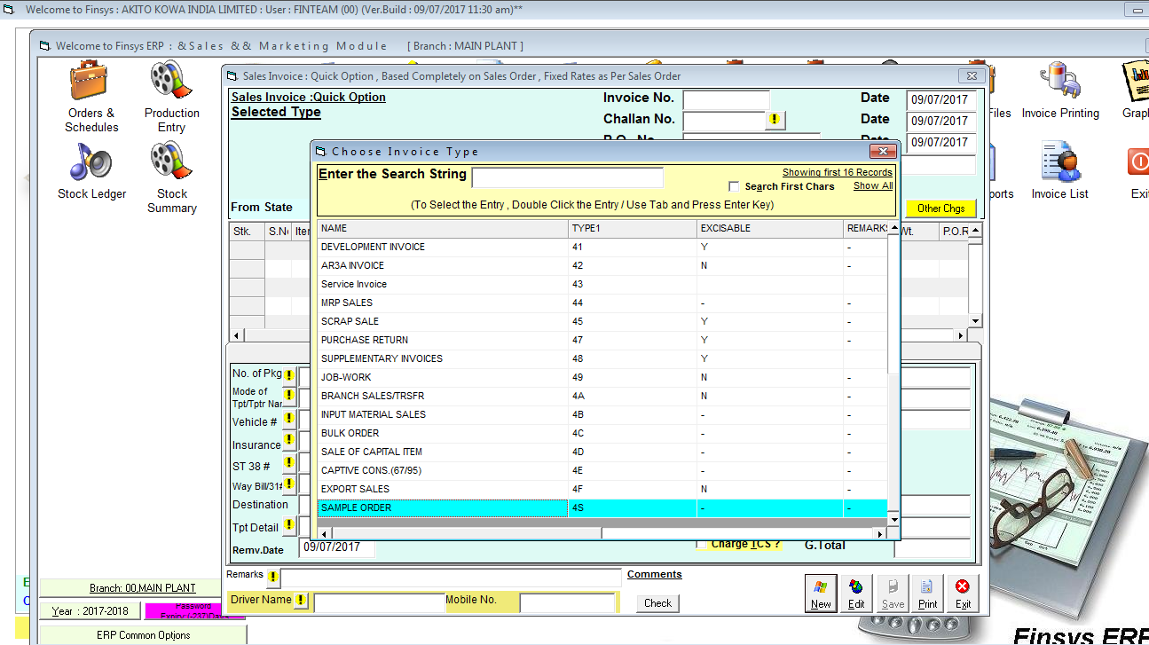
Select Invoice Type = 4S

Slide 11
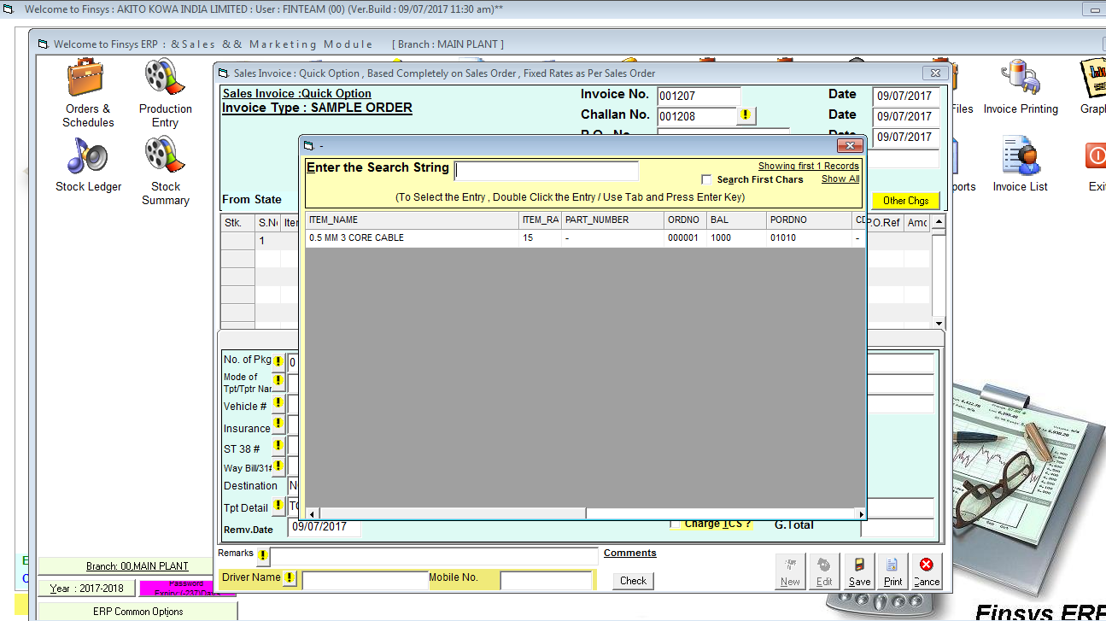
Select Customer

Slide 12
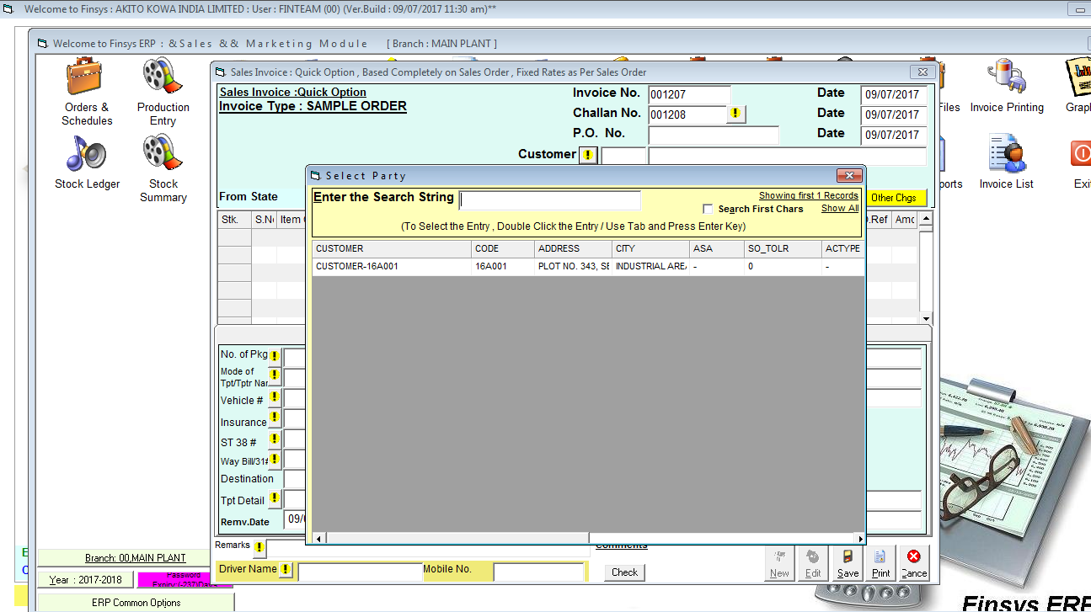
Select Items

Slide 13
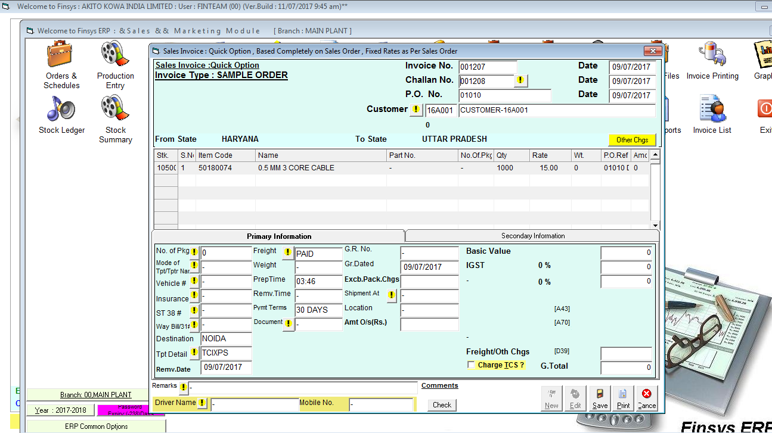
Invoice Screen

Slide 14
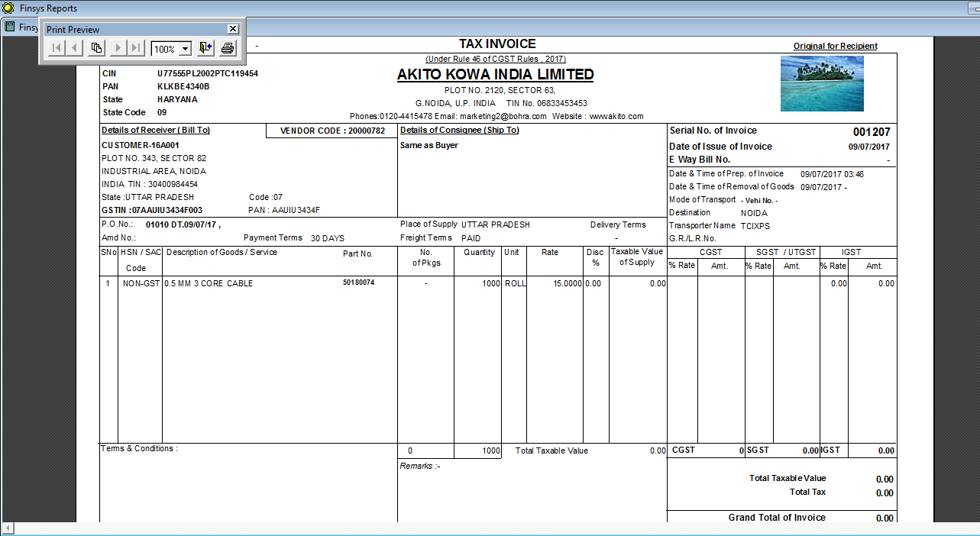
Print Out of Invoice

Slide 15


