Slide 1



Webtel GST Solution
CS Vijay Sahni
vijay@webtel.in

Slide 2
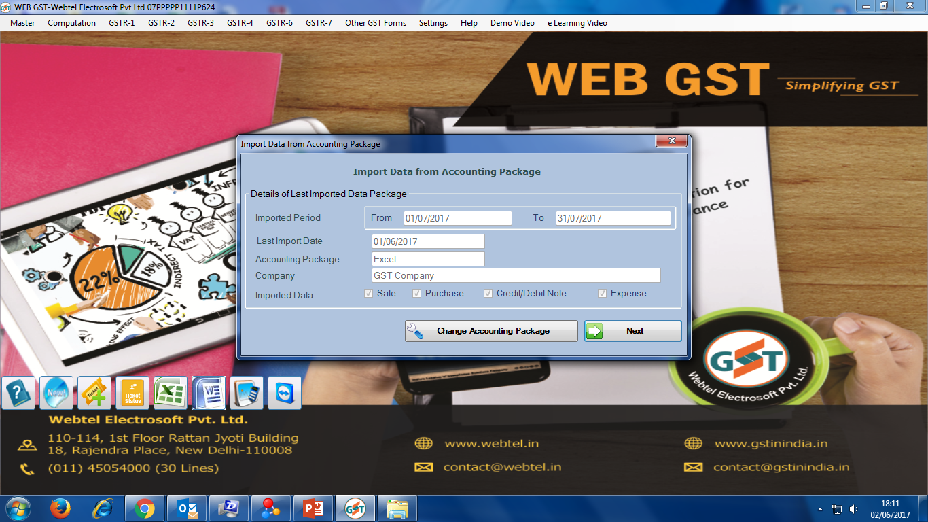
Select FINSYS
FINSYS

Slide 3
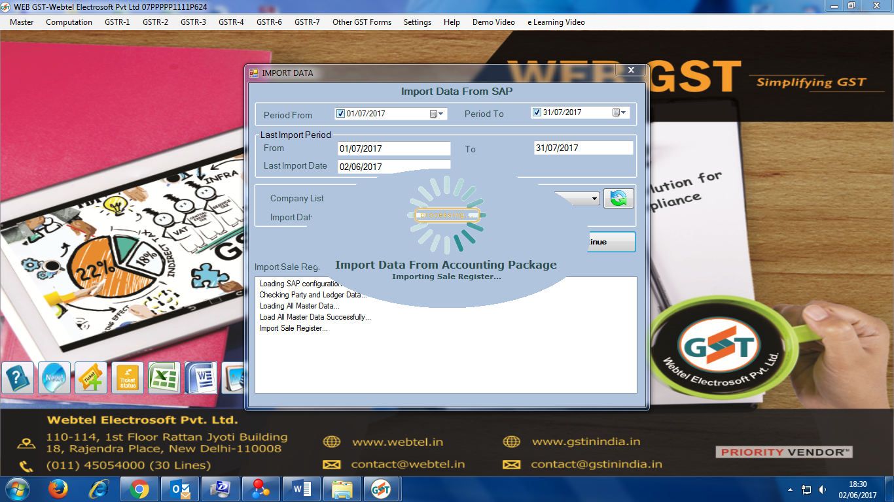
Import from FINSYS
FINSYS

Slide 4
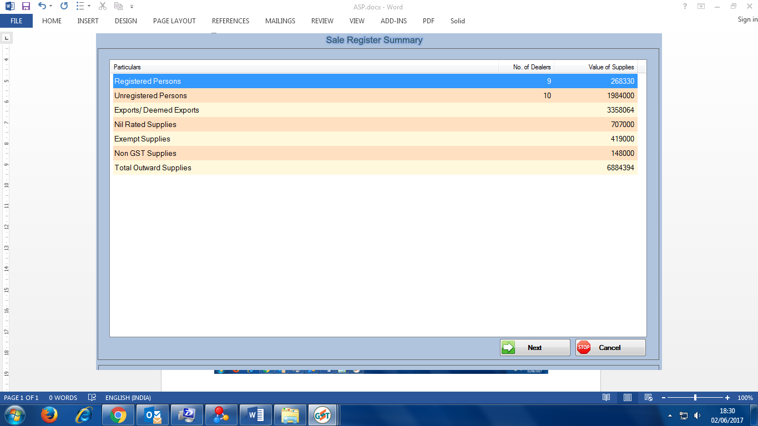
Sales Summary

Slide 5
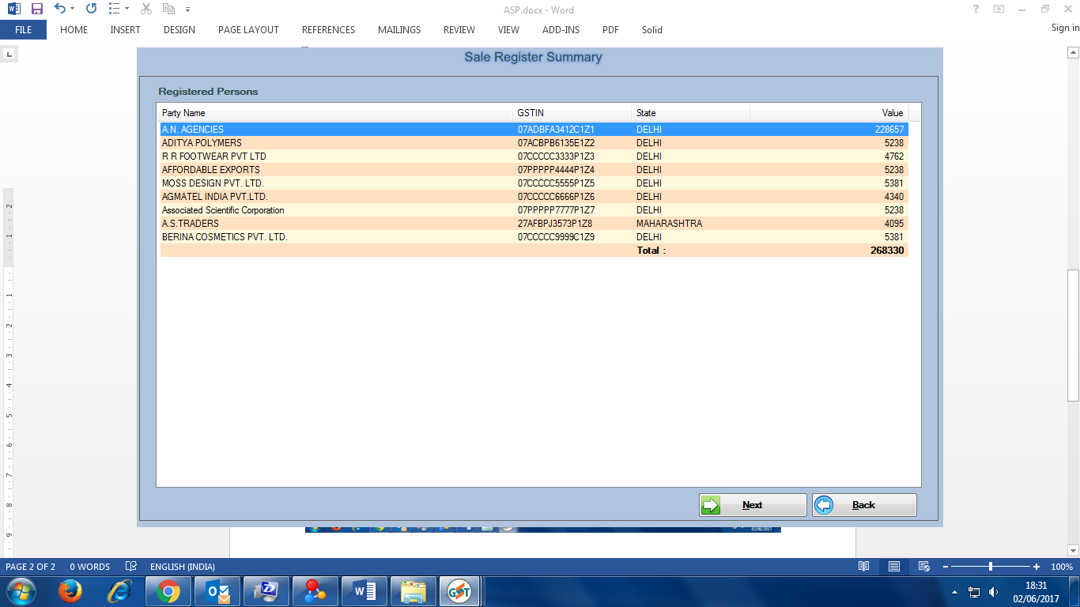
Partywise Sales Summary

Slide 6
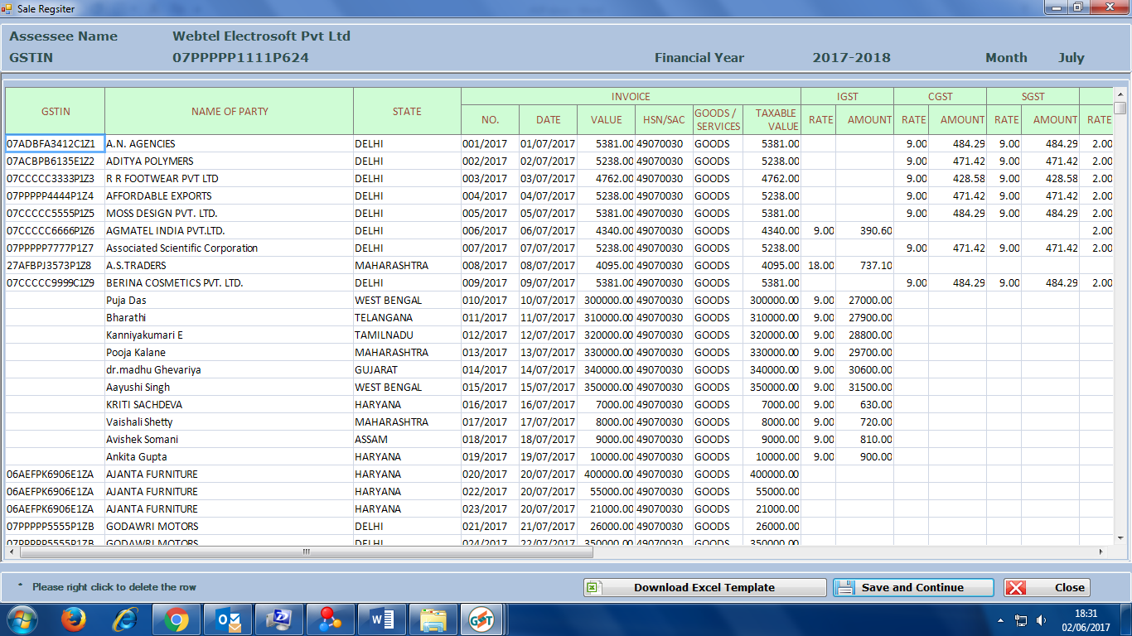
Sale Register Imported

Slide 7
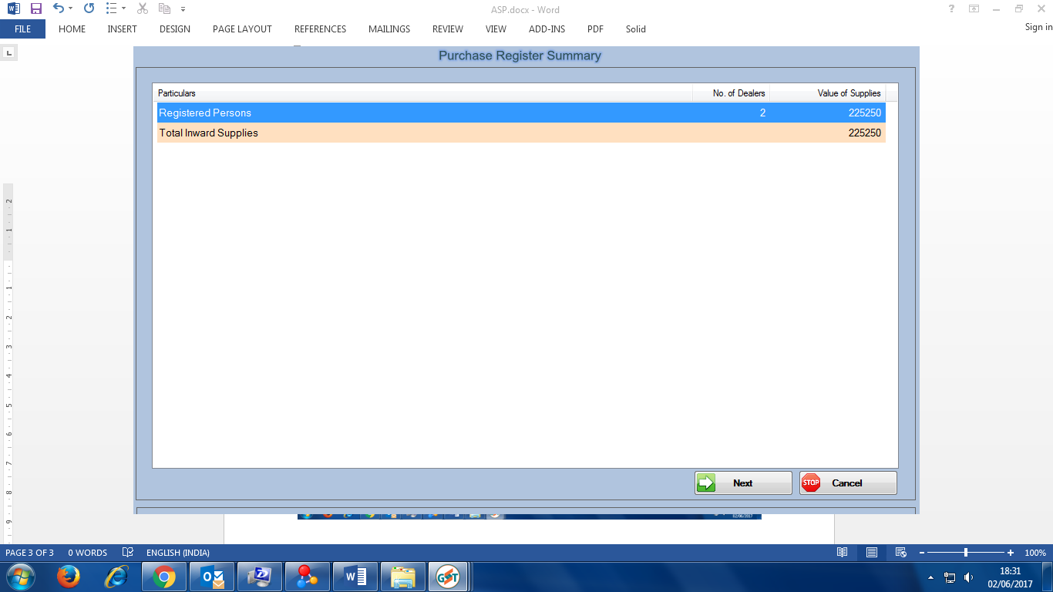
Purchase Register Summary

Slide 8
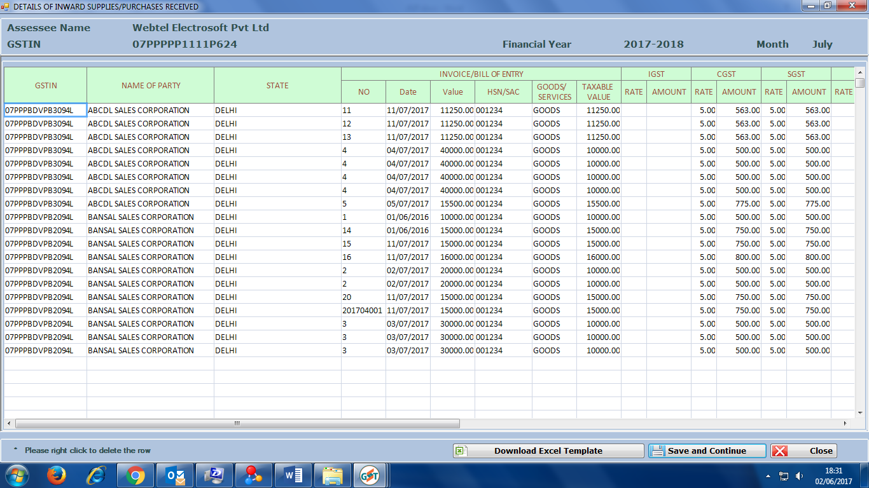
Purchase Register Imported

Slide 9
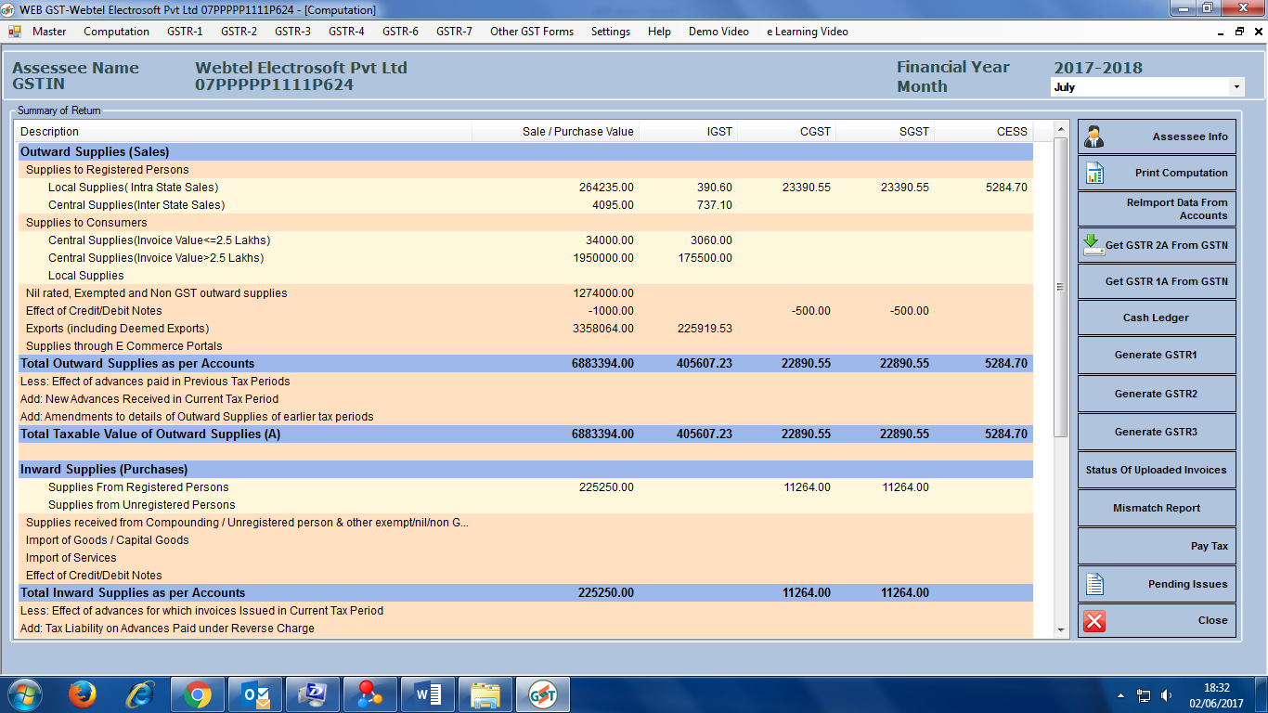
Computation

Slide 10
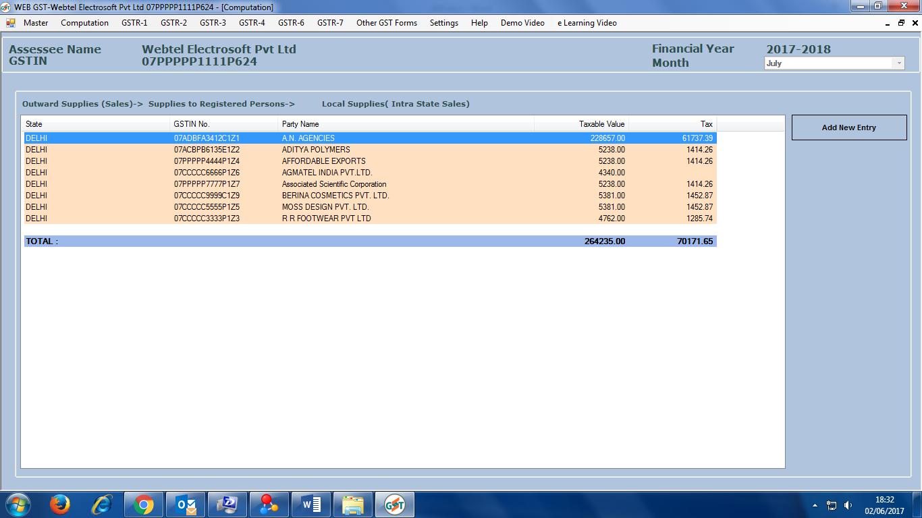
Local Supplies : Regd Person

Slide 11
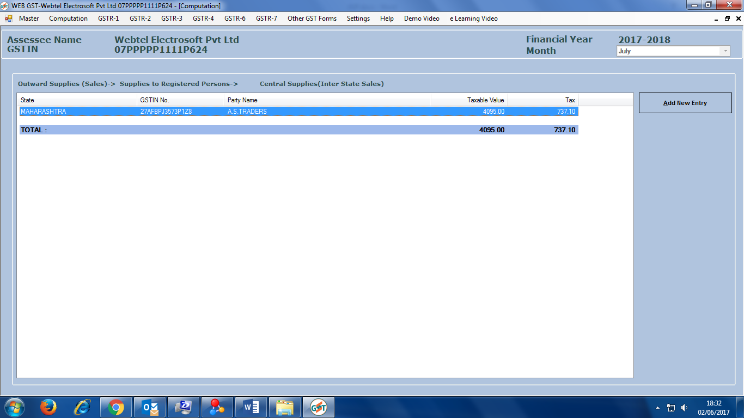
Central Supplies Regd Person

Slide 12
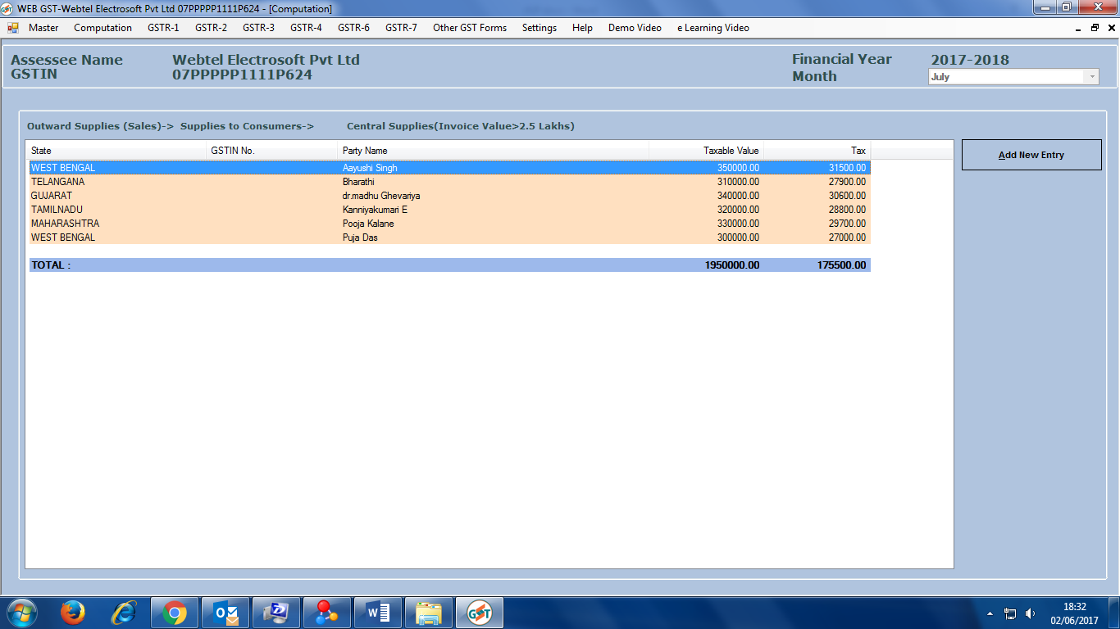
Central Supplies > 2.50 lacs

Slide 13
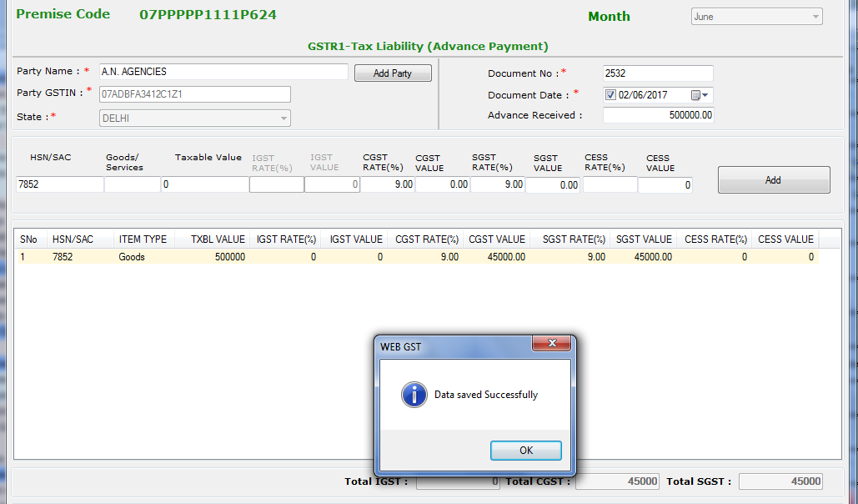
Payment of Advance

Slide 14
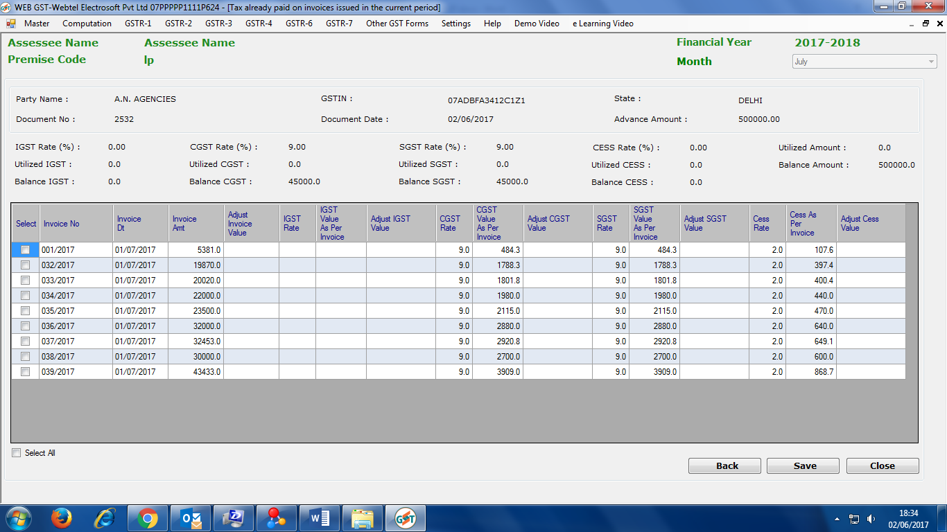
Adjustment of Advance

Slide 15
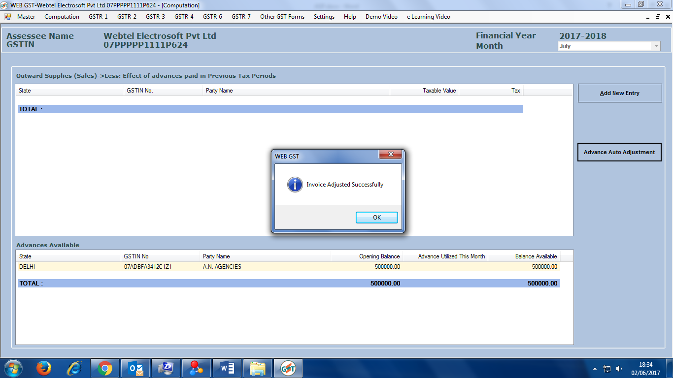
Advance Auto Adjustment

Slide 16
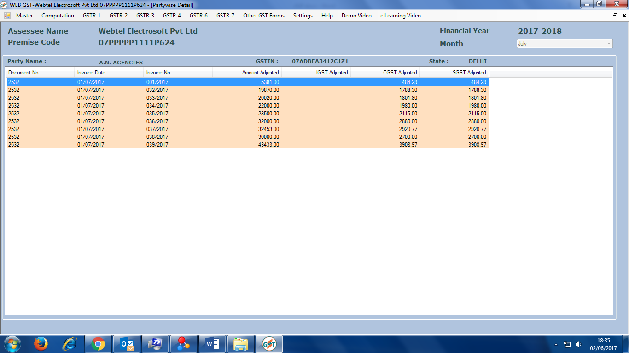
Advance Auto Adjustment

Slide 17
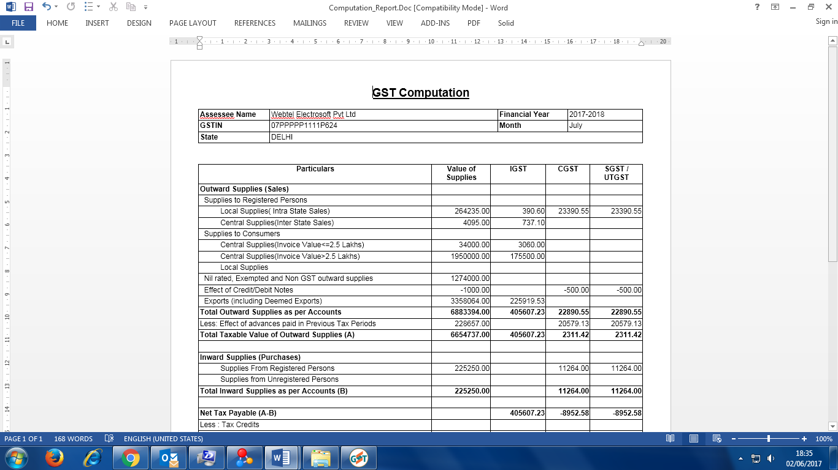
GST Computation

Slide 18
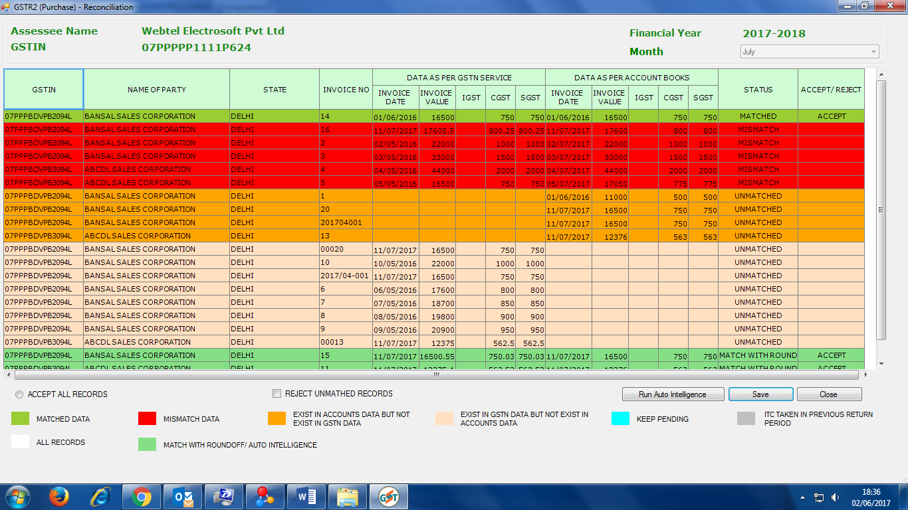
Matching with GSTR-2A

Slide 19
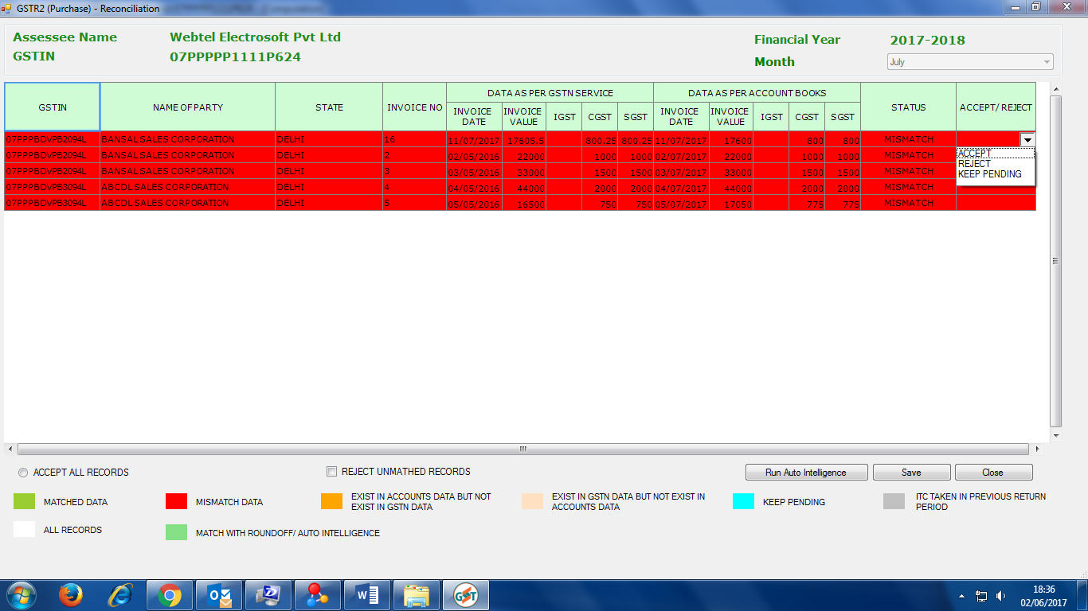
Unmatched Records

Slide 20
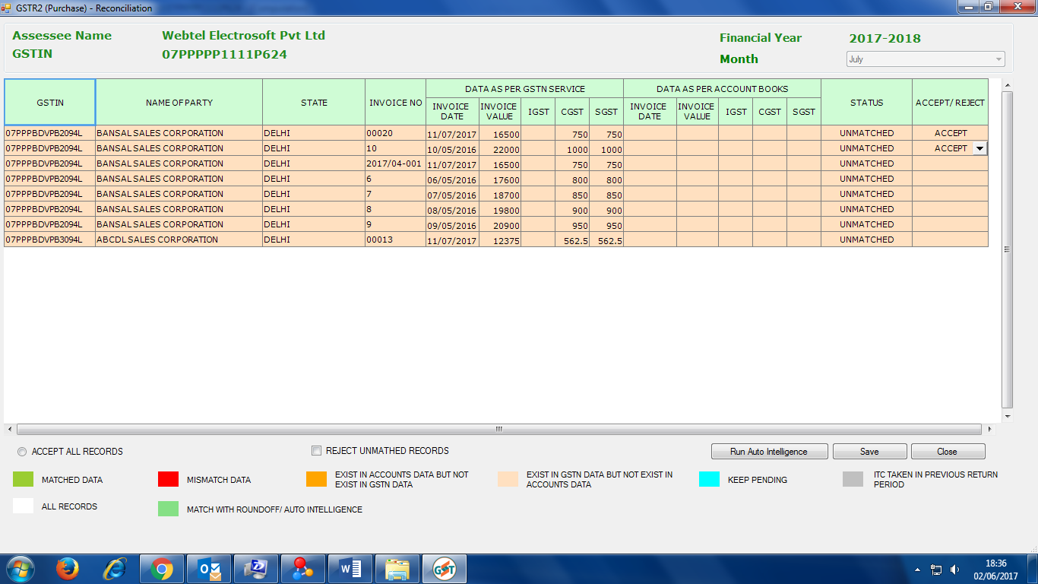
Details NOT in ERP

Slide 21
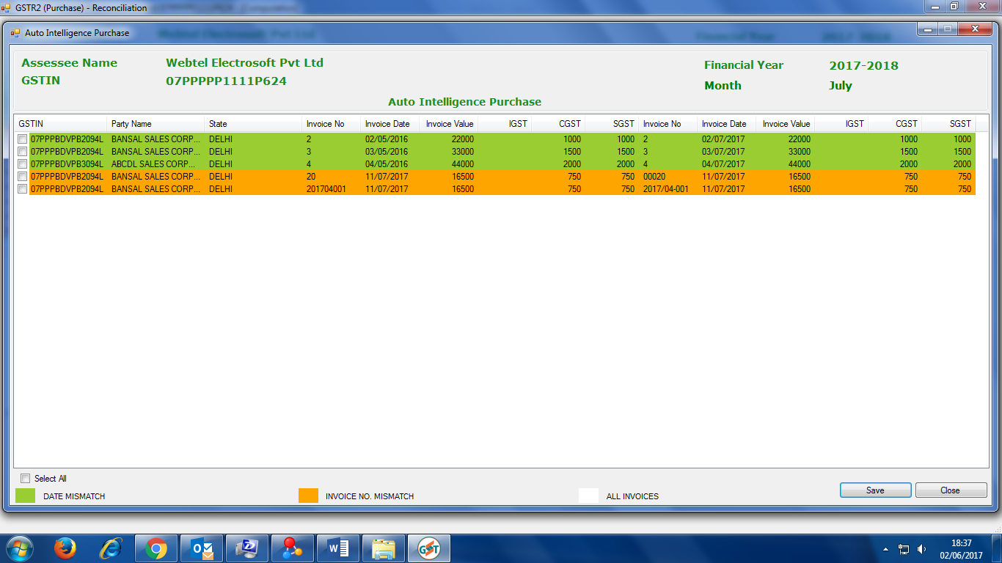
Auto Intelligence Matching

Slide 22
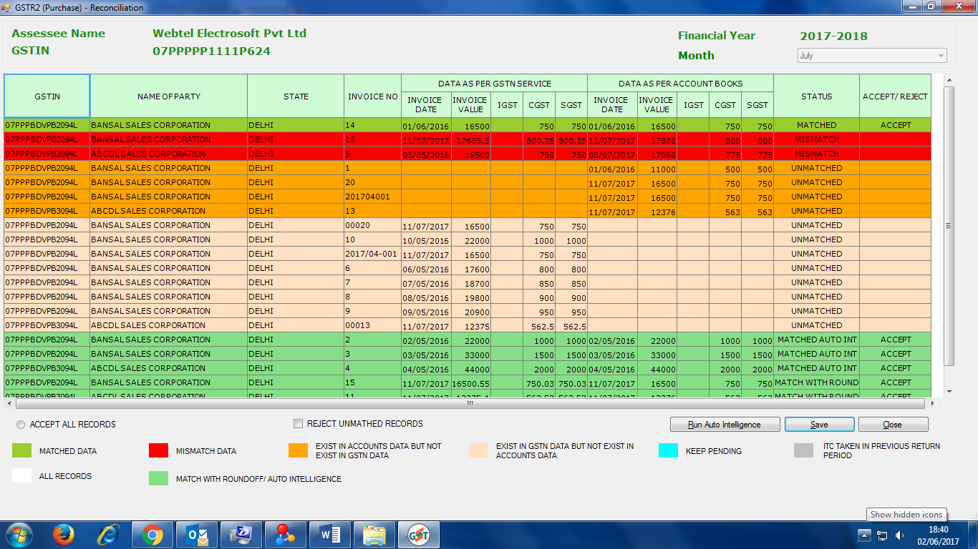
Accepted Records

Slide 23
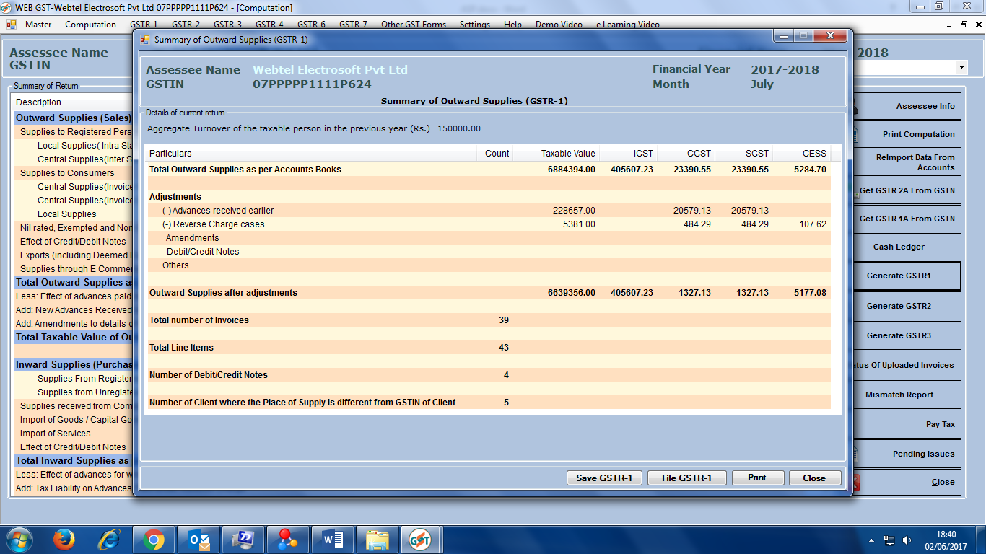
Summary GSTR-1

Slide 24
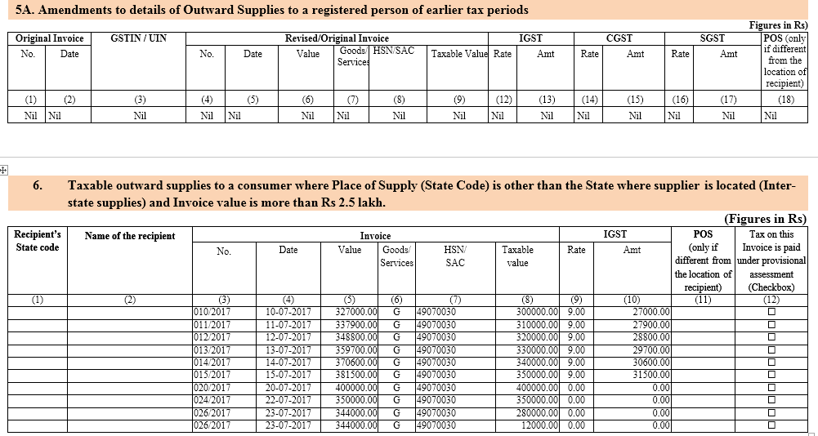
GSTR-1

Slide 25
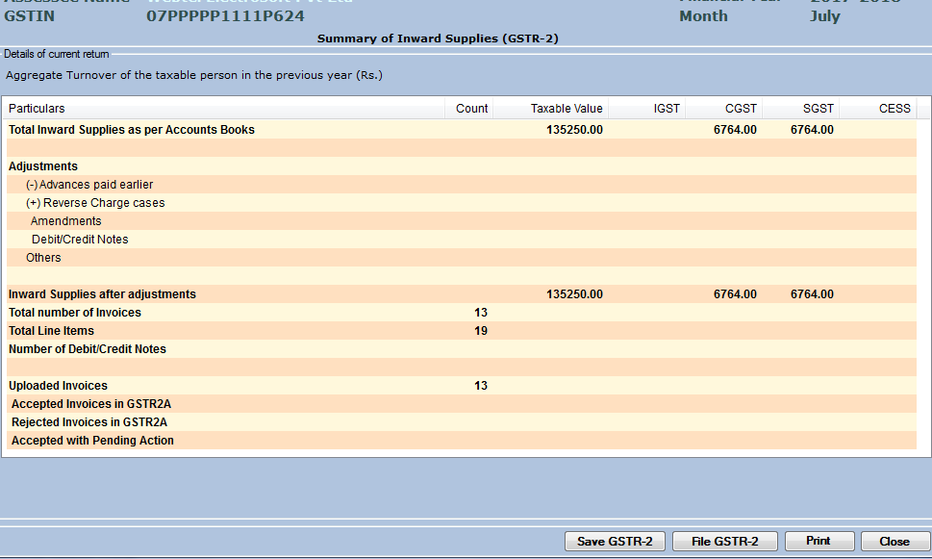
Summary GSTR-2

Slide 26
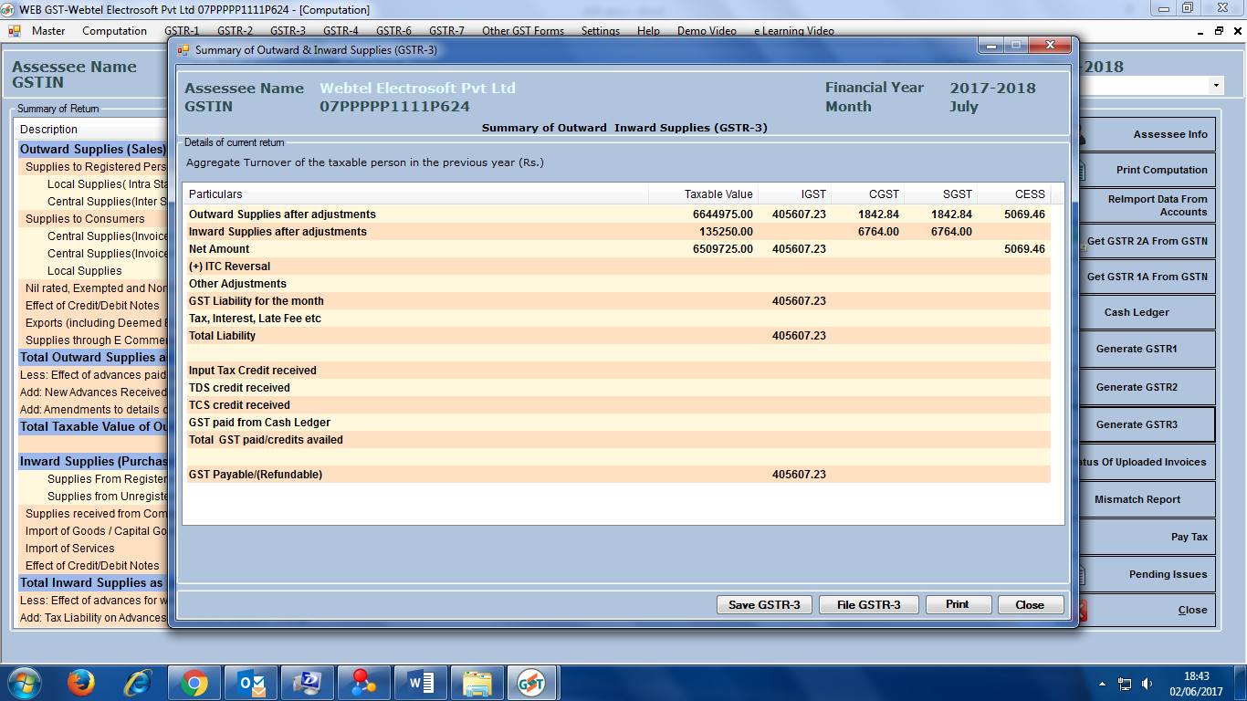
Summary GSTR-3

Slide 27
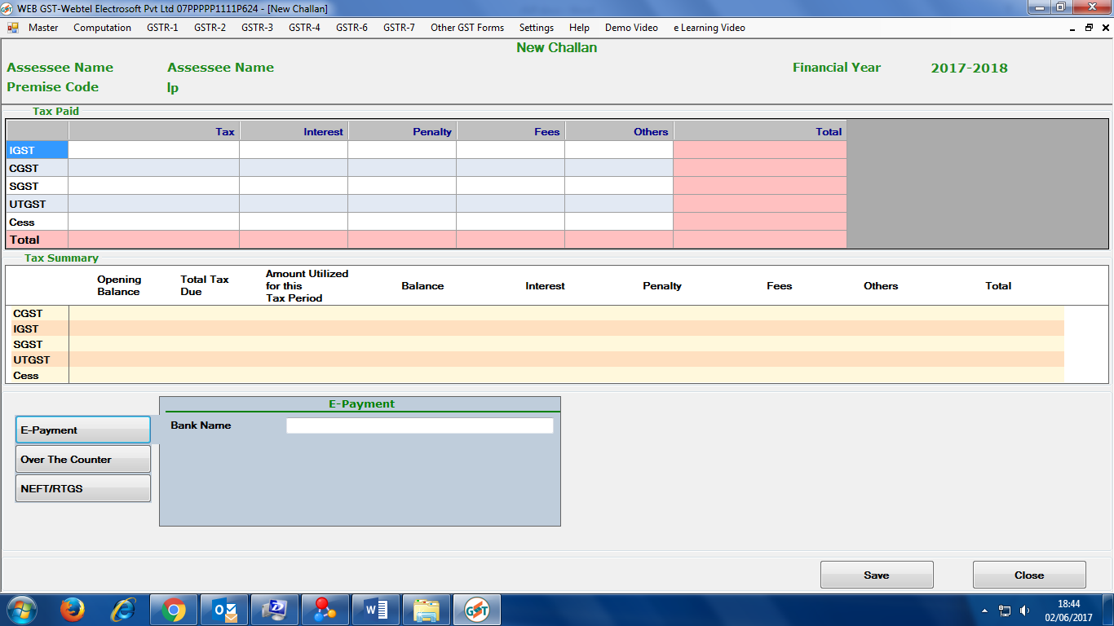
Tax Payment

Slide 28
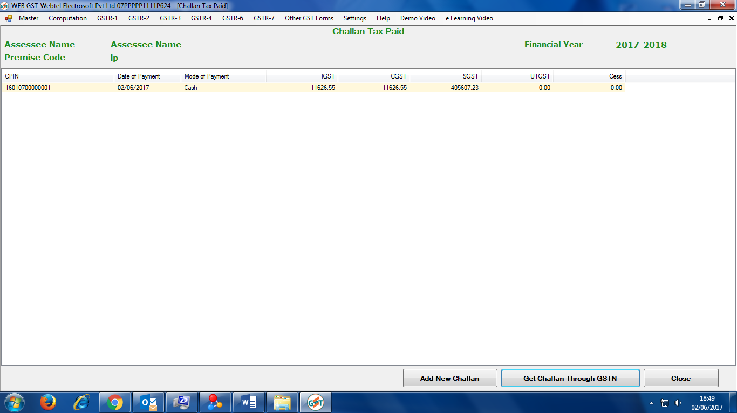
Import of Tax paid from GSTN

Slide 29
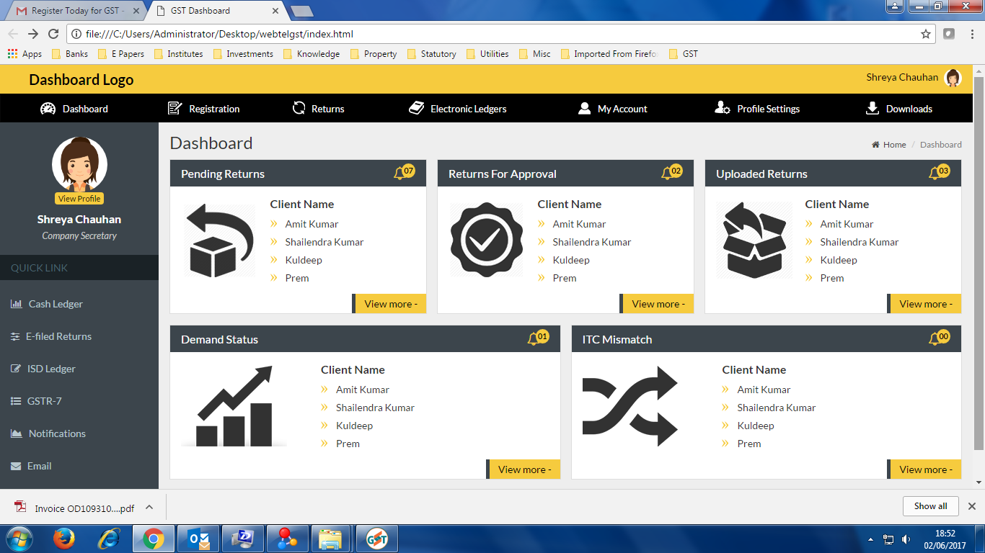
Dashboard

Slide 30
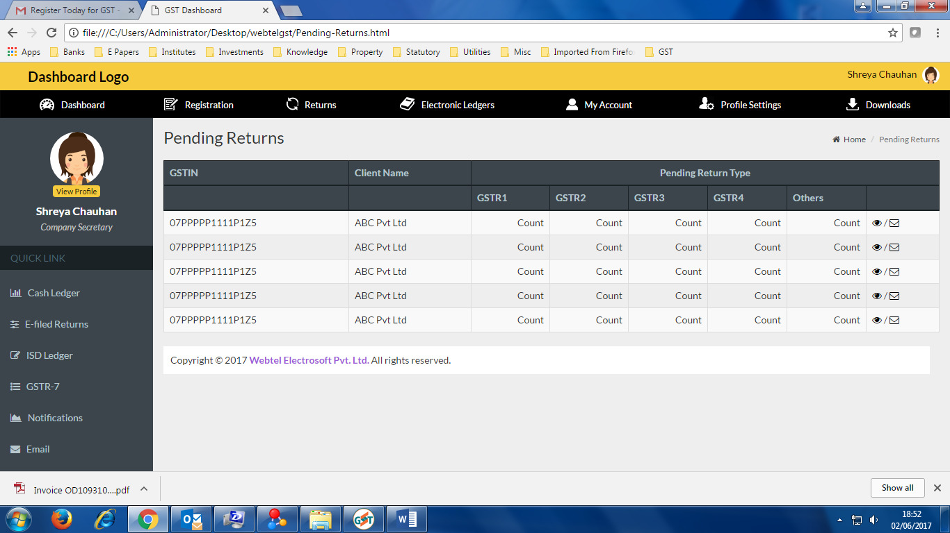
Dashboard

Slide 31
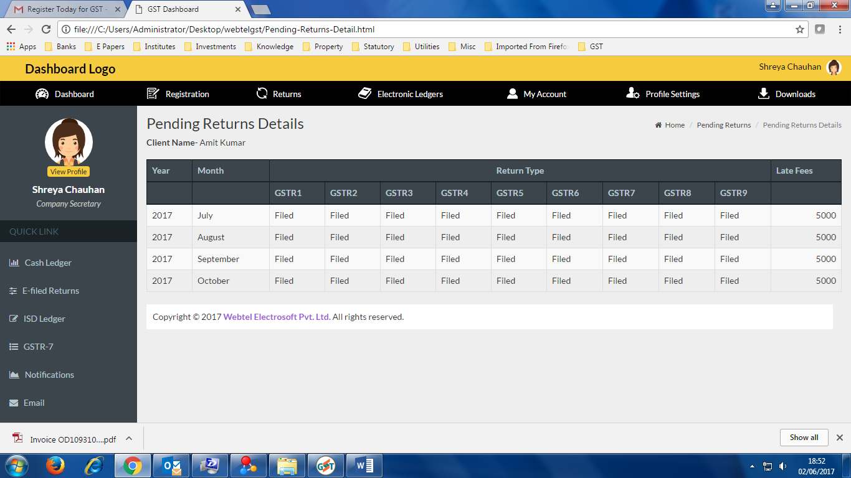
Dashboard

Slide 32
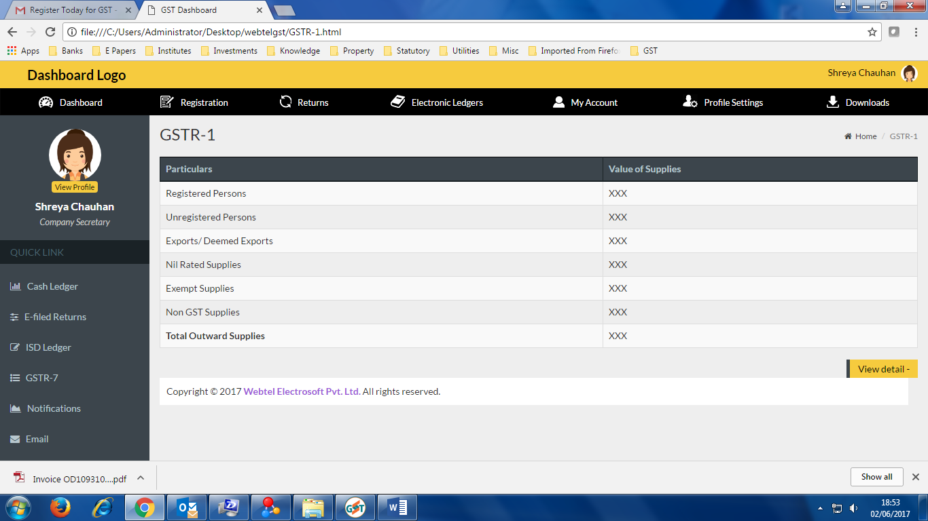
Dashboard

Slide 33
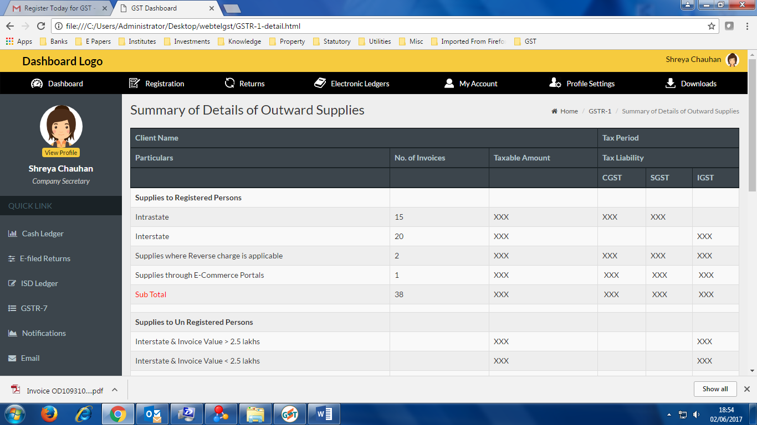
Dashboard

Slide 34

CS Vijay Sahni
vijay@webtel.in

