Slide 1

Panel Speaker 2
Rajendra Kapoor
FCS , LLB, B.Com(Hons)
Webtel Electrosoft Pvt Limited
Email : rkapoor [at] webtel.in
Company Secretary
Founder : Webtel Group
12000 customers
Pan-India presence
Ministry of Company Affairs XBRL, Webcasts, Eminent Speaker at PHDCCI, ICAI, ICSI

Slide 2



GST
One Nation | One Tax |One Solution
Our mantra : Simplifying GST
WEB GST

Slide 3
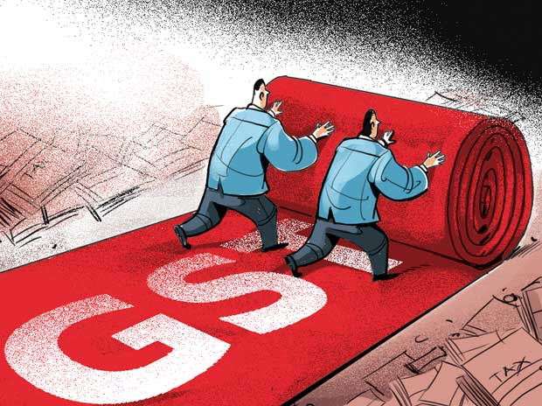
GST – Set for roll out on 1st July, 2017
GST will have a significant impact on every business enterprise irrespective of size and sector. Conceptually it is similar to existing Excise/VAT Laws but much different.
Technology is going to play an important role in its Implementation.
Preparedness across all levels is of absolute importance.
WEB GST

Slide 4

Webtel– India’s Leading ‘e’ Compliance Solutions Company
Webtel Electrosoft Pvt. Ltd. is India’s Leading ‘e’ Compliance Solutions Company.
We were amongst India’s first companies to launch TDS Software in 2003.
We became part of every ‘e’ initiative of Govt. and provided solutions for TAX, VAT and Service Tax.
We were amongst India’s first companies to launch XBRL Software in 2011 and are market leaders today.
Having PAN India presence and have more than 25000 satisfied customers.
Registered with Income Tax Department, NSDL, MCA & HMRC ,U.K.
Company Law Ready Reckoner, a utility developed by Webtel is hosted on Ministry of Corporate Affairs Portal.
In addition to Compliance products, we deal in other solutions like Payroll Management, Compliance Dashboard, Web-e-Sign etc.
We recently completed successful implementation of Web-e-Sign at E & Y and is in pipeline with Genpact . It was implemented with Apollo Munich last year.
WEB GST

Slide 5









Serving Esteemed Clients:

Slide 6




















MEDIA & TELECOMMUNICATION
1
CORPORATES
2
3
PROFESSIONAL ARENA
ICAI
HOSPITALITY SECTOR
4
GOVERNMENT SECTOR
5
6
BANKING SECTOR

Slide 7

Milestones achieved by Webtel in GST
First Company to provide GST ‘e’ Learning Solution - More than 15 Hour of Comprehensive Learning by Leading Experts in Indirect Taxation – Subscribed & Appreciated by more than 5000 Professionals & Corporate.
GST Migration Utility
Provided GST Migration Utility for ICICI Bank customers
GST Impact calculator
Web - GST – A Complete Software Solution for GST Compliance Management – Simplifying GST.
GSP solution. Webtel is providing an ASP –GSP integrated solution.
WEB GST

Slide 8

FINSYS – WEBTEL Collaboration
Webtel is India’s Leading ‘e’ Compliance Solutions Company.
FINSYS is India’s Leading ERP provider working with best brains.
Accounting>ASP>GSP>GSTN – Journey is on an uneven road in a shortest possible time.
Implementation of GST mandates Best of Accounting and Compliance teams to collaborate.
FINSYS – WEBTEL collaboration will give a complete end to end solution for timely compliance by FINSYS customers.
WEB GST

Slide 9




Roadmap to GST Implementation
Learning/Training
Understanding Law and Procedures.
Accounting Integration
Changes in Accounting System & Manpower Training.
Compliance
Return Filing and Reconciliation on Monthly Basis.
Audit/Assurance
GST Dashboard – Maker/Checker concept for Zero Errors.
GSP Services
Uploading of Returns through GSP
WEB GST

Slide 10

One Stop Solution – GST ‘e’ Learning
Learning/Training
GST ‘e’ Learning Solution by Webtel provides Convenient, Continuous and Comprehensive Learning of GST Law and Procedures. The content, methodology and delivery compliments Seminars, Books & other Learning materials are so effective that there is hardly any need for anything on Learning/Training front.
WEB GST

Slide 11

Accounting Integration
Actual implementation of GST starts with making changes in Accounting System. Changes in Accounting primarily include:
Updating GSTIN of Suppliers/Buyers in Accounting Master.
Coding Tax Nomenclatures i.e. CGST, SGST, IGST, UTGST and cess etc.
Soft/ Hard coding Rates of Taxes.
Describing HSN codes for different items.
Other Necessary changes in reports.
Setting output file structure for integration/absorption by GST Return Preparation Utilities.
While other ERP providers are still in process FINSYS has already made necessary changes.
FINSYS – WEBTEL collaborated to give and end to end Accounting and Compliance Solution to FINSYS customers.
Webtel has integrated GST Compliance utility with FINSYS ERP.
How data will flow from FINSYS to Web-GST will be explained in next presentations.
WEB GST

Slide 12
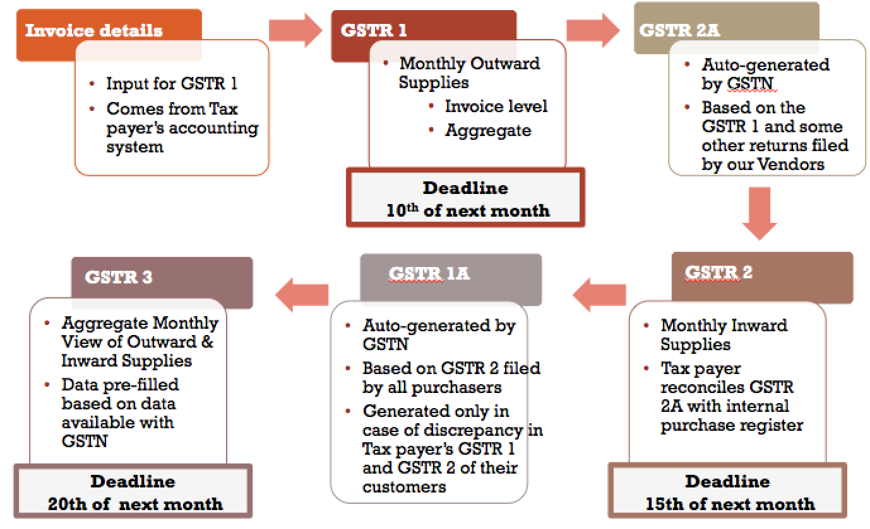
Compliance
WEB GST

Slide 13

Compliance
Compliance – Web GST – A Complete Solution for GST Compliance Management– Simplifying GST
Minimum 3 Returns have to be filed every month on different dates;
Need for putting up a separate compliance team for GST;
Getting Data from GSTN Portal;
Reconciling Input Tax Credit on Inward and Outward supplies;
Adjusting input tax credit on Advances etc;
Determining Net Tax Liability, and other such processes ;
A good tool to manage is required
Web GST has many unique features simplifying GST Compliances
WEB GST

Slide 14

Features of Web-GST
Integrated with Accounting Software(s)
Auto Import of Inward, Outward supplies and Expense data from
Accounting Software.
Dynamic GST Computation
Generate and Upload GSTR 1,2,3,4,5,6,7,8 and 9
Download GSTR 1A from GSTN.
Invoice Mismatch Report in different categories
Auto Intelligence Matching Facility
Reconciliation of Mismatched Invoice Data
Download Cash Ledger from GSTN
Calculation of Net Tax Liability
Online Payment of Taxes
Creation of ISD Master and distribution of Input Tax Credit
Print Computation and Return Forms
Status of Uploaded Invoices
Report of Debit/Credit Notes with inbuilt mailing facility
Report of Pending/Uploaded Returns
Backup and Restoration of Data with Live Update Facility
Many more features......
WEB GST

Slide 15

Audit/Assurance- GST Dashboard
Since minimum 3 Returns are to be filed every month, which involves uploading and downloading of voluminous invoice data, Reconciliation of Input Tax Credit etc., it is important to adopt maker-checker concept. Dashboard facilitates real time synchronization of data from maker to the checker and thus reduces the possibility of errors.
Features of GST Dashboard
User Management
Synchronization of data from software to Dashboard on Real Time
View/Upload Returns
Status of Pending/Uploaded Returns at a glance with drill down
facility.
Facility for Approval of Returns for Uploading
Demand Status
ITC Mismatch
Cash Ledger
Notifications for delay in filing, mismatches etc.
ISD Ledger
Reconciliation Summary
Computation of GST Liability
WEB GST

Slide 16

Webtel ASP –GSP Services work flow
Data will flow from FINSYS ERP to WEB GST
User
Required data will get populated on a Computation sheet which will display GSTR1,2,3
Web- GST will prepare return and submit through Integrated GSP pipe
User to do Reconciliation in Web GST Application
Integrated GSP Pipe with Web GST application
GSTN Server
WEB GST

Slide 17





GST Compliance Presentation
Key Consideration Areas
Automation
Tax payers will have to provide invoice information in a certain format depending on the return, requiring automation at tax payer’s end
Managing Complexity
Buyer’s returns will be auto-populated based on seller’s filings, leading to complexity of matching invoices and accepting/rejecting/modifying them.
Need for Efficiency
Most tax payers will have to file minimum 3 returns a month calling for an efficient & automated system
Tracking Scenarios
Events like auto-reversals will require tax payers to keep track of different scenarios
Collaborative Workflow
Collaboration between different business functions viz. procurement, finance, audit and compliance will require an efficient role based work flow system

Slide 18

Thank You
Alone We can do so little , Together we can do so much..
It’s because of you Dear Customers that We are coming together…
WEB GST

