Slide 1
Opening Facts on Law
By Sangeet Kr Gupta

Slide 2
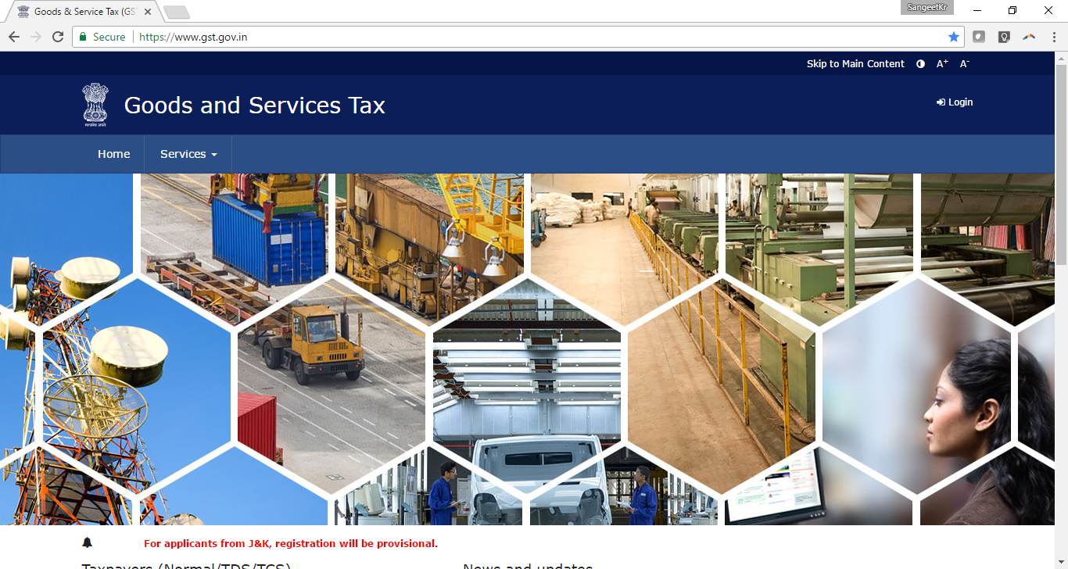
Pure Law… Where are we now ?

Slide 3
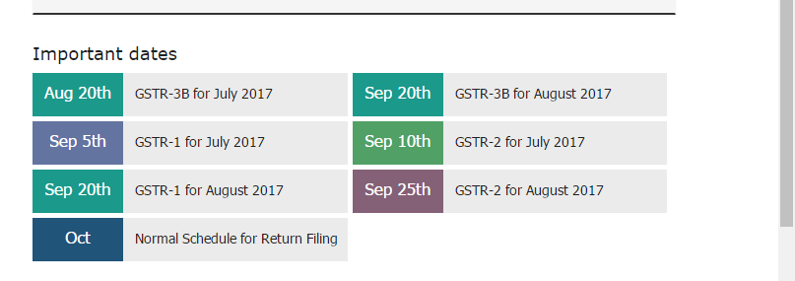
New Dates
GSTR 3B : simplified return for 2 months
GSTR 1 : Sales side
GSTR 2 : Purchase Side

Slide 4
Unorganised Vendor
Bill from a unregistered vendor
  You do RCM
And
  File the RCM return page
So, He is also linked in GST
Govt knows
Govt will aggregate his sales, and know his Nation-wide sales

Slide 5
When will I get the ITC ?
1
Receive the goods
2
Receive the bill
3
He file the return correctly
4
He pays the tax

Slide 6

Small Vendor / unorganised but registered vendor
Example : Karol Bagh / Kashmere Gate Market
Risks
He charges, you pay
  But, he does not file
  You do not get the ITC
You lose the GST

Slide 7
Small Vendor / unorganised but registered vendor
Risk 2
He charges, you pay, he files,
  But, you did not inform your GST number
  You lose the GST
Risk 3 : You did inform him
  Yet he did not enter it correctly
  You again lose the GST

Slide 8
Solution ?
Don’t buy from unorganised vendor
Don’t buy from occassional / casual vendor
If you do,
  Ensure he does all required steps

Slide 9

Effect on the market ?
Benefit to organised sector ?
Sales up ?
Unhealthy Competition down ?

Slide 10

Next : Travel & Food

Slide 11
Travel & Business Promotion Exp
Very normal
Normally Hotel in name of employee
  Pays bill,
  You reimburse
  Currently get Modvat ? Answer is NO
Future, will we get GST ? Yes, if
  GST number is specified by him
  Our name specified by him

Slide 12
and
Same State ?
  Mumbai, CGST and SGST of Maharashtra
  We cannot get SGST credit of that state
  Unless he gives IGST bill / ( if possible )

Slide 13
Credit Cards
In Corporate names
  And not personal names
Till now ZERO rebate
  You can get in future
  If you complete

Slide 14
How not to Loose the ITC ?
Proper Records by your company
Proper Return filing by your vendor
  On time

Slide 15
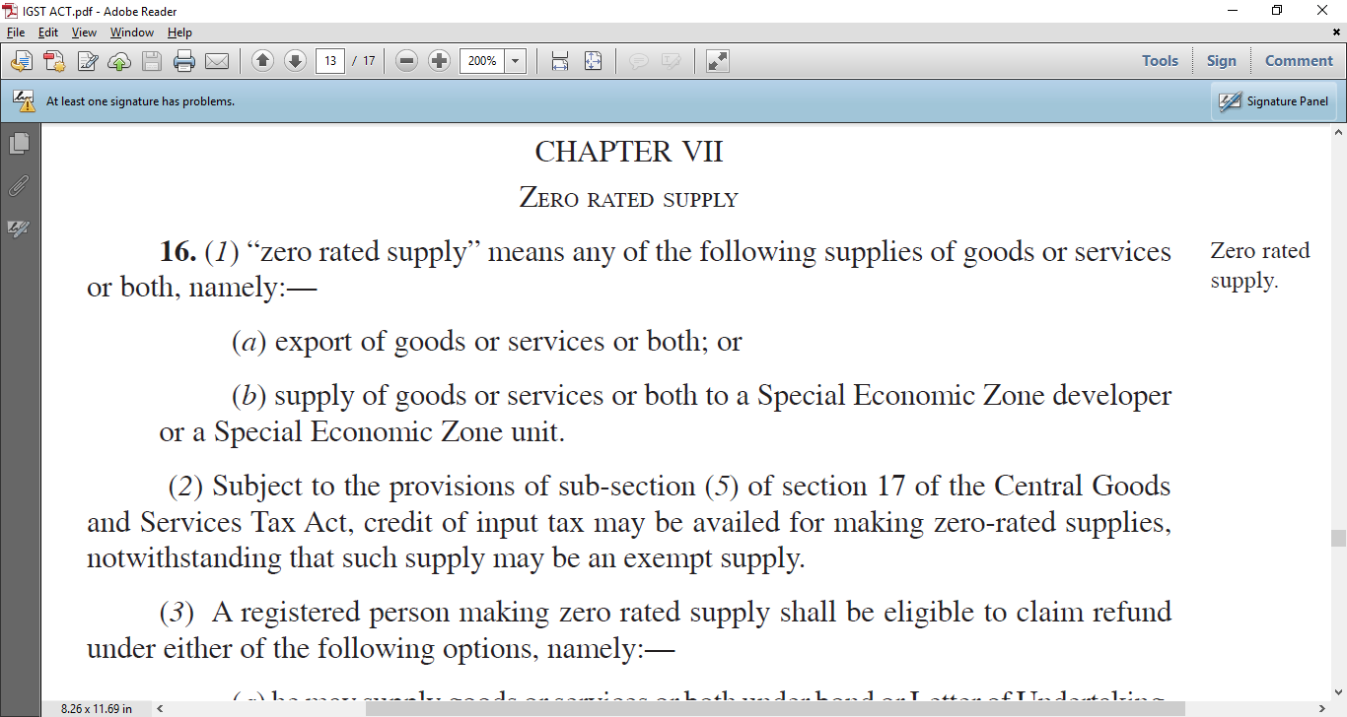
Supply to SEZ Units : Zero Rated

Slide 16
ITC is allowed for whole of SEZ Supply
IGST Act : 16(2) Subject to the provisions of sub-section (5) of section 17 of the Central Goods and Services Tax Act,
credit of input tax may be availed
for making zero-rated supplies,
notwithstanding that such supply may be an exempt supply.
Benefit : No proportionate disallowance.

Slide 17
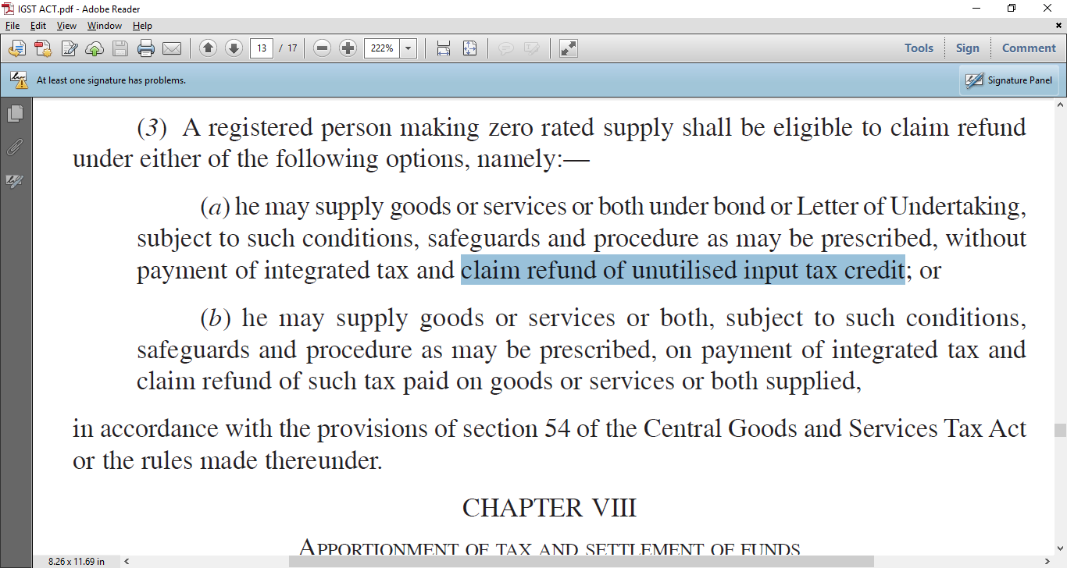
Exporter can get Refund of ITC in his books…. Based on the Either “bond” / debit in books

Slide 18


Slide 19
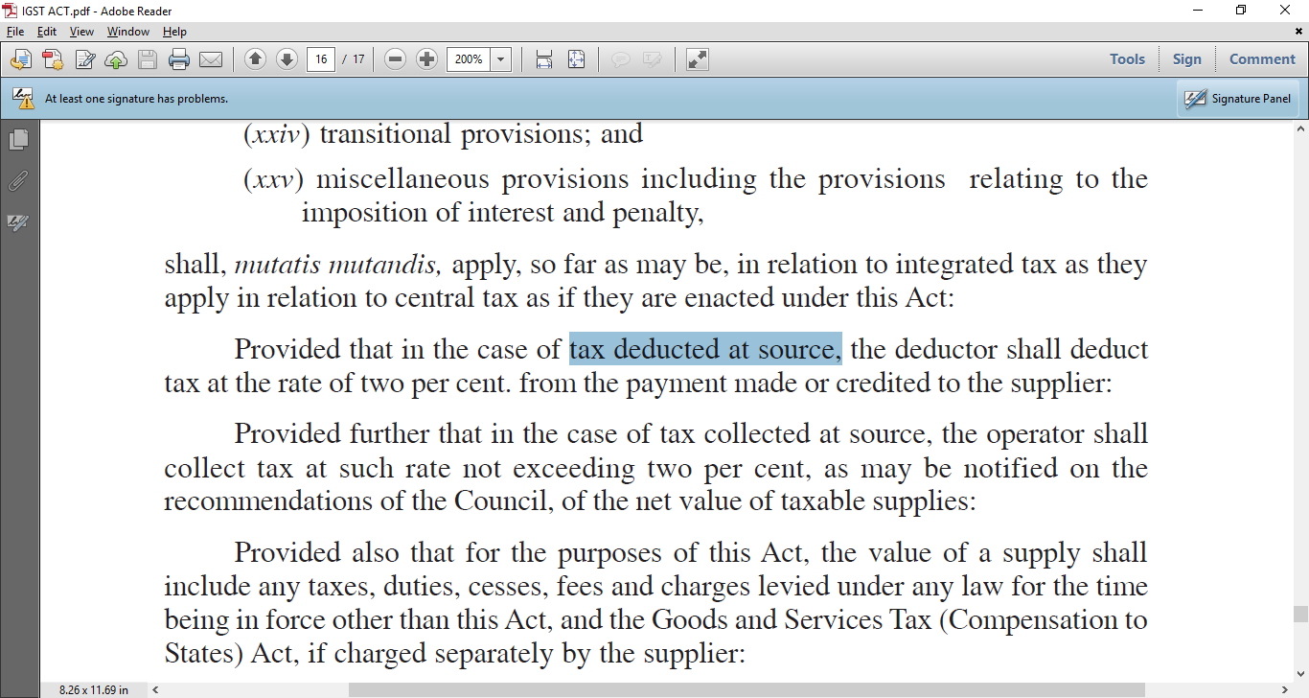
TDS : IGST 2% : Section 20 IGST Act

Slide 21
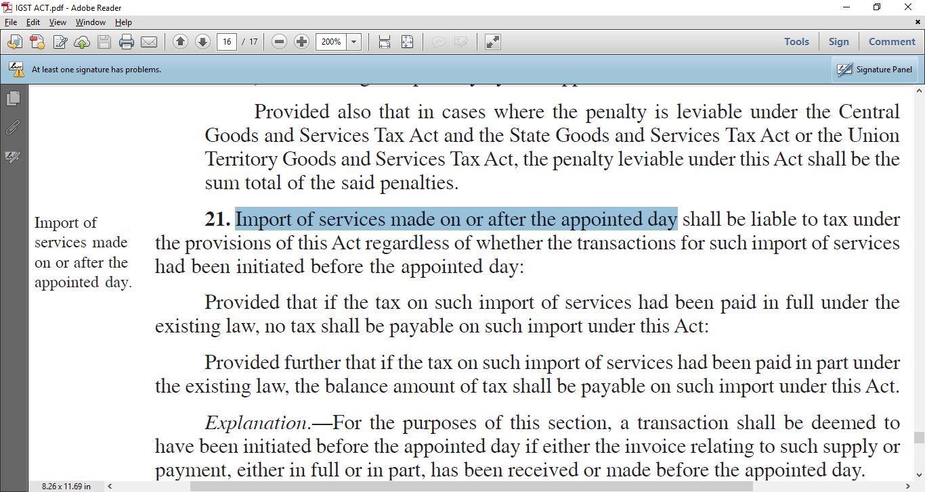
Even if Transaction started earlier

Slide 22
Example : Import of services
Chinese Machinery Manufacturer
sending engineers, contract is old, invoice received
money is already sent, but service is now
So, IGST on services will be NOW
You cannot say, it is old contract / in Transit

Slide 23
Rate ?
Rate ?
18%
Pay by ?
You
But you can take full ITC , so no Direct loss … for a normal GST manufacturer

Slide 24
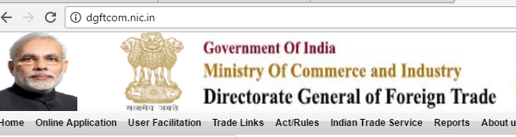
Next : Exporters & Importers

Slide 25
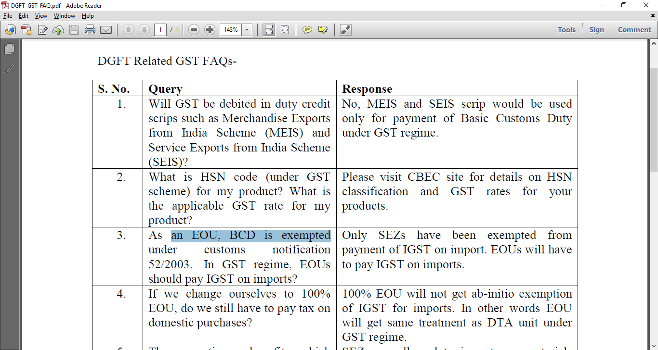
Official FAQ by DGFT

Slide 26
Important point for SEZ and EOU’s
BCD used to be exempted for EOU
As an EOU, BCD is exempted under customs notification 52/2003. In GST regime, EOUs should pay IGST on imports ?
Answer 1 : Only SEZs have been exempted from payment of IGST on import.
Answer 2 : EOUs will have to pay IGST on imports

Slide 27
EOU == similar to DTA now
If we change ourselves to 100% EOU, do we still have to pay tax on domestic purchases?
100% EOU will not get ab-initio exemption of IGST for imports.
In other words EOU will get same treatment as DTA unit under GST regime.

Slide 28
SEZ vs EOU
The exemptions , benefits which are available to 100% EOUs , SEZs in current regime , whether the same will be available under the GST regime ?
Answer :
SEZs are allowed to import raw materials duty free (Basic Customs Duty and IGST both exempted).
But, 100%EOU will have to pay IGST, Input Tax Credit (ITC)/ refund of which can be taken after exports as per ITC/ Refund Rules

Slide 29
Export Duty Credit Schemes
Will GST be debited in duty credit scrips such as Merchandise Exports from India Scheme (MEIS) and Service Exports from India Scheme (SEIS)?
Answer : No, MEIS and SEIS scrip would be used only for payment of Basic Customs Duty under GST regime.

Slide 30

Important
It is advised to update IEC in GSTIN.
also check correct PAN in GSTIN and IEC.
From 1st July, in all shipping bills declaration of GSTIN will be mandatory for claiming ITC/refund of GST.

Slide 31
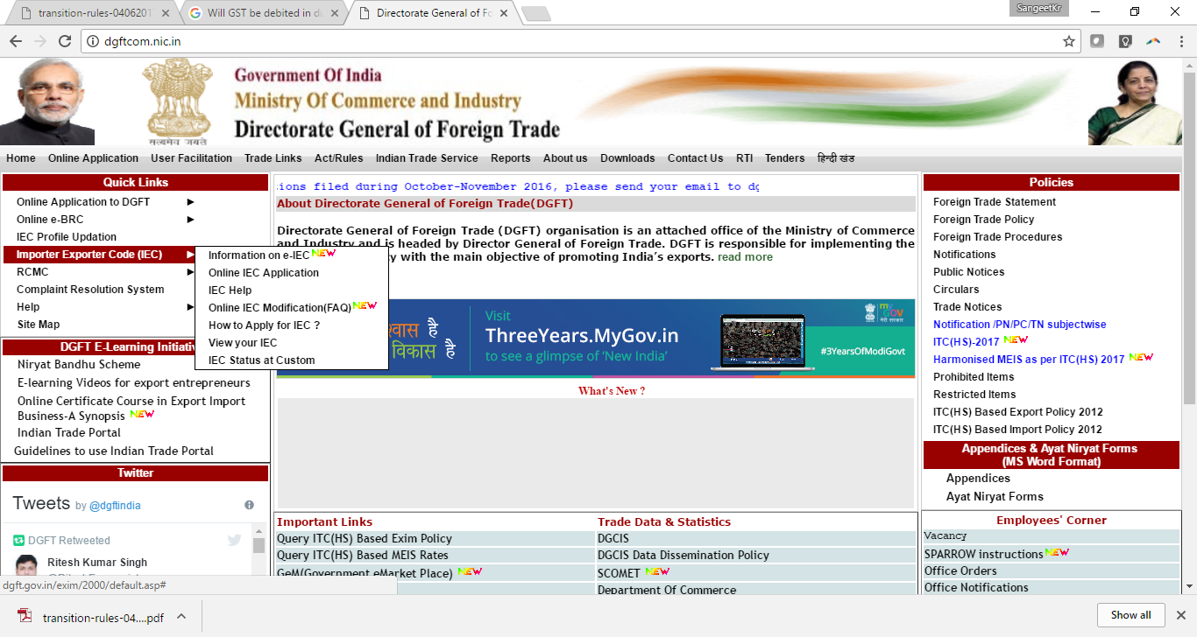
DGFT Guidelines on IEC

Slide 32
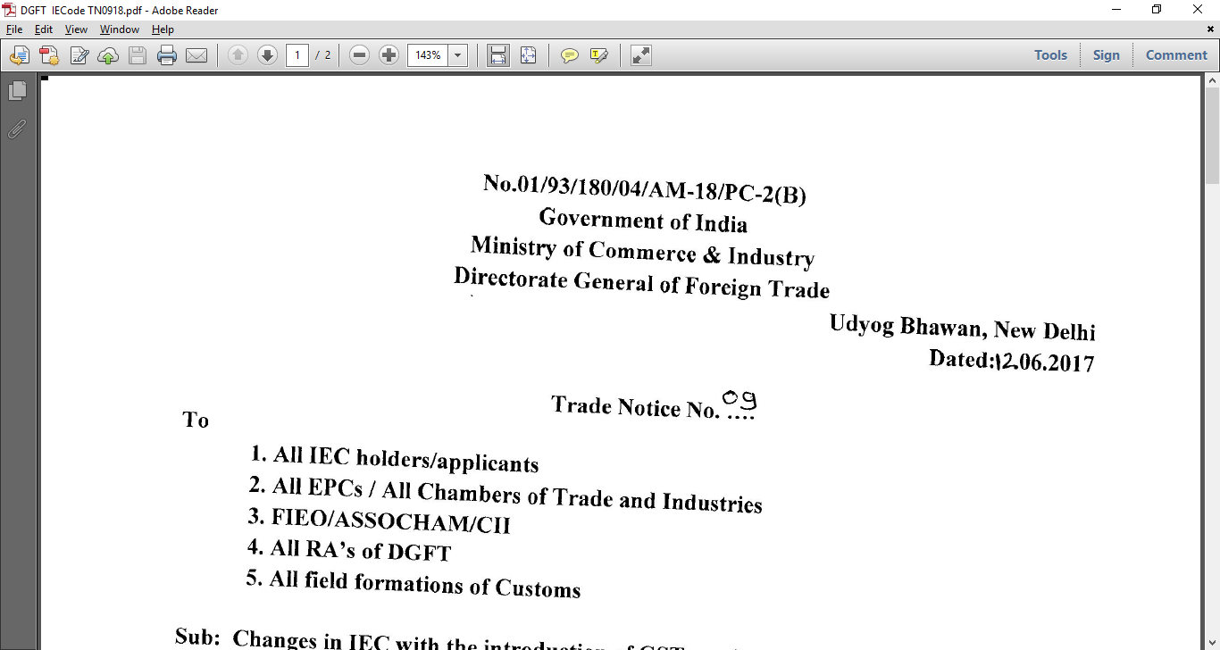
Notification 12th June 2017

Slide 33
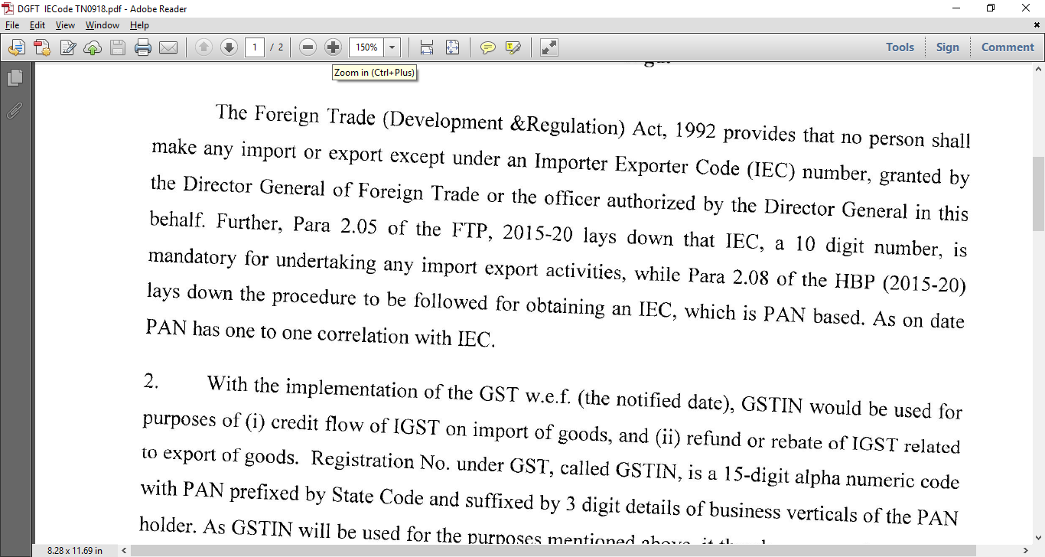
No person can do any Export or any Import without IE Code

Slide 34
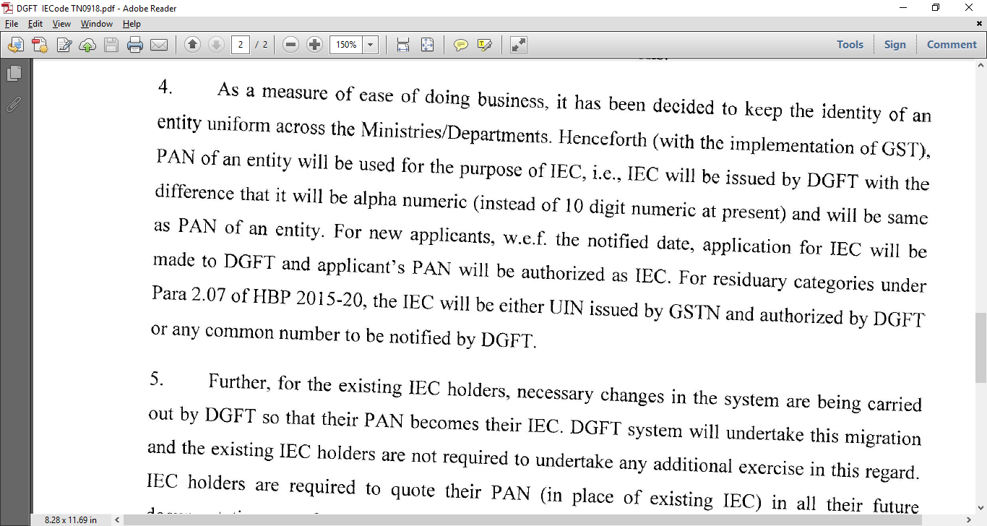
PAN is now the New IE Code

Slide 35
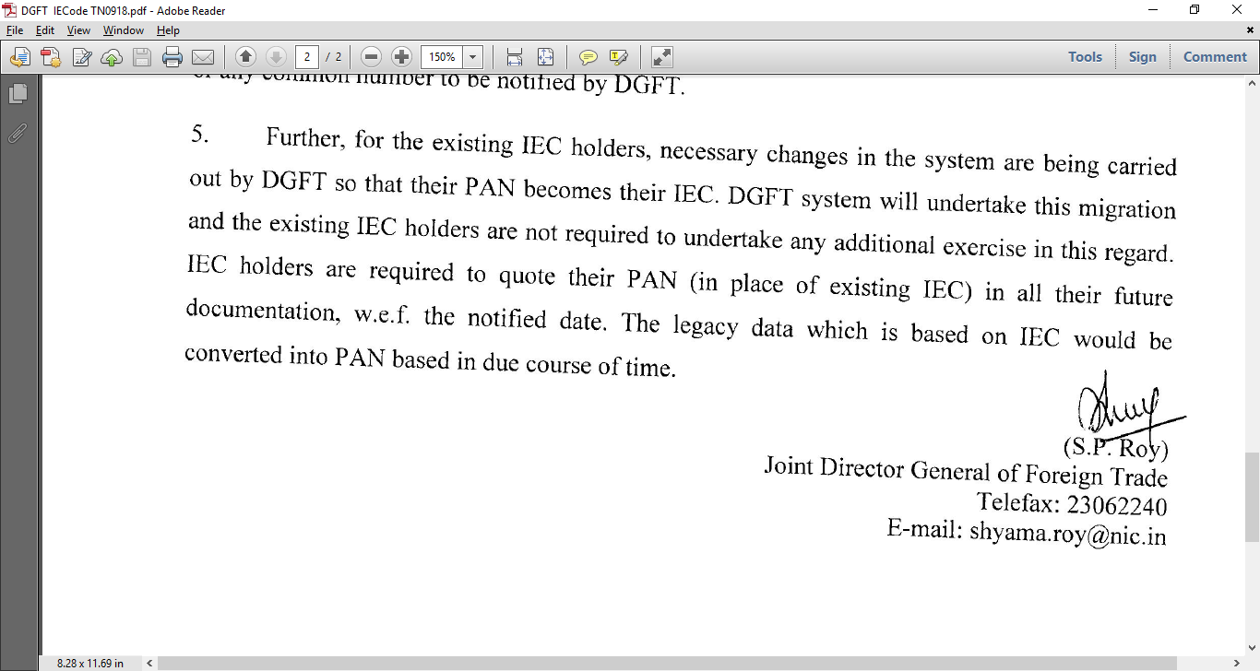
Existing Co = PAN automatically being shifted as your IEC// nothing to do by you for Regn
But….. Use this in Future in IEC cell

Slide 36
Advance Licences

Slide 37
Advance Licences ? What status ?
Under GST regime, can we get duty free benefit (all duties exempted) if we import using Advance authorization?
No, only basic customs duty will be exempted on imports made under Advance Authorisation.
IGST will have to be paid on imports.
IGST paid on import will be refunded on making exports .

Slide 38
Benefit / Loss
Benefit
  Paperwork problems… finished
  Liason Costs,
  Proofs,
  evidences, costs, delays
  Harassment
  Tax with interest compounded for 5 years
But…
  money investment/cash flow problem

Slide 39
Quantification of Loss ?
How much additional Cash flow invested ?
  Average 18% on the Import value… blocked
Interest cost :
  12% of 18% = 2.16% of Bare cost
Compare it
  to transaction costs of getting Advance licence
  And then squaring it off

Slide 40
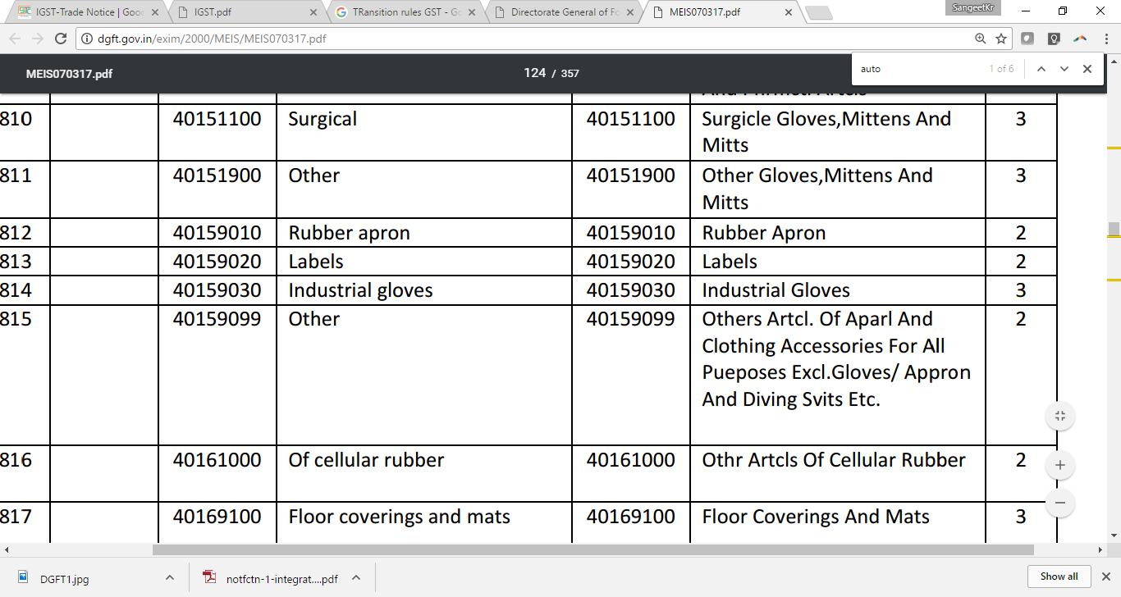
MEIS :: Later on

Slide 41
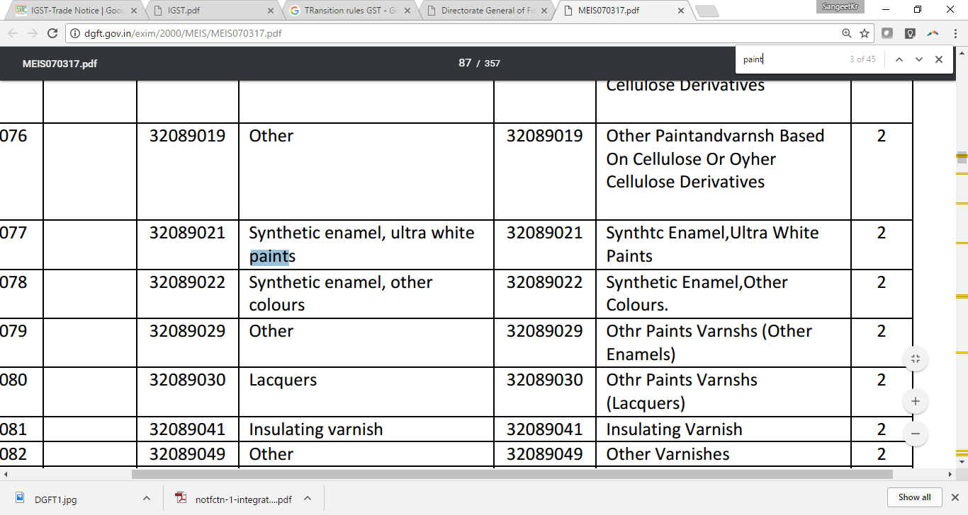

Slide 42
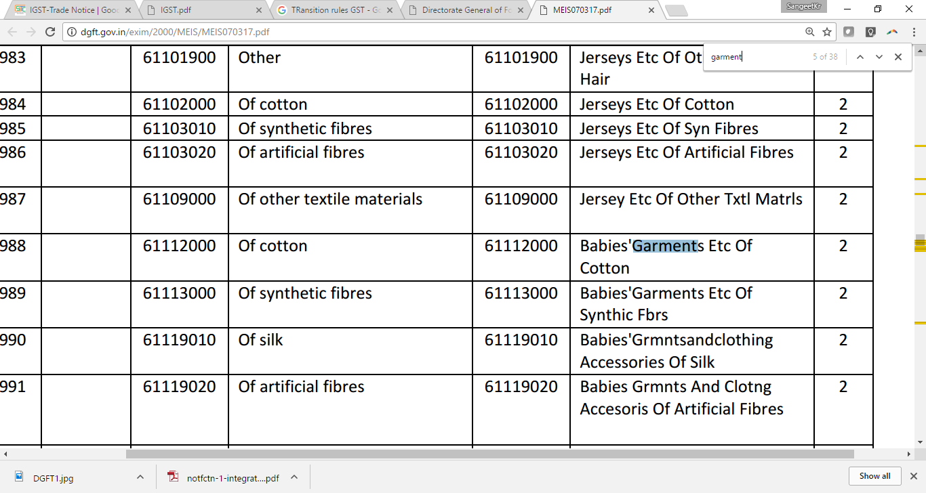

Slide 43

Transition Rules

Slide 44
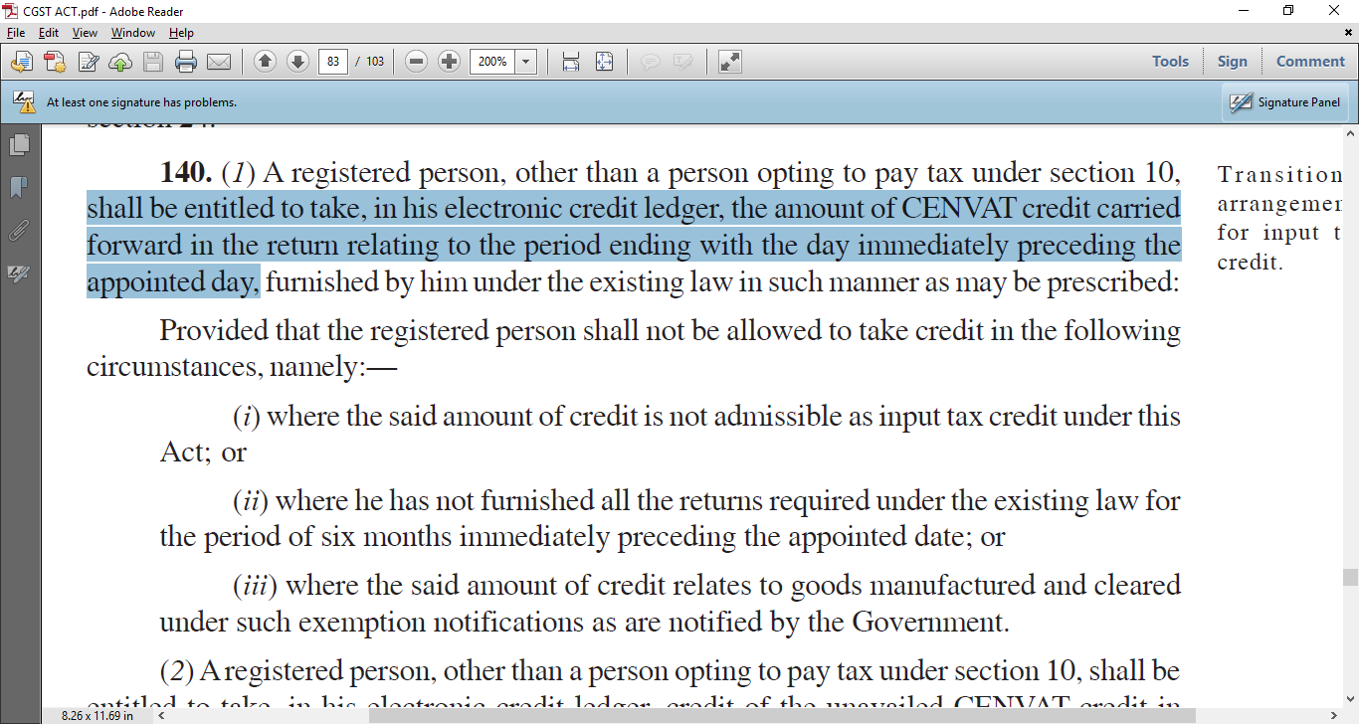
Section 140 of the CGST : allowed 100% credit of all modvat In your books (*)

Slide 45
RG-23C = Part 2 ( Capital Goods )
(2) A registered person, other than a person opting to pay tax under section 10, shall be entitled to take, in his electronic credit ledger,
credit of the unavailed CENVAT credit in respect of capital goods,
not carried forward in a return, furnished under the existing law by him,
for the period ending with the day immediately preceding the appointed day in such manner as may be prescribed:

Slide 46
Condition… of course
Provided that the registered person shall not be allowed to take credit
unless the said credit was admissible as CENVAT credit under the existing law
and is also admissible as input tax credit under this Act.

Slide 47
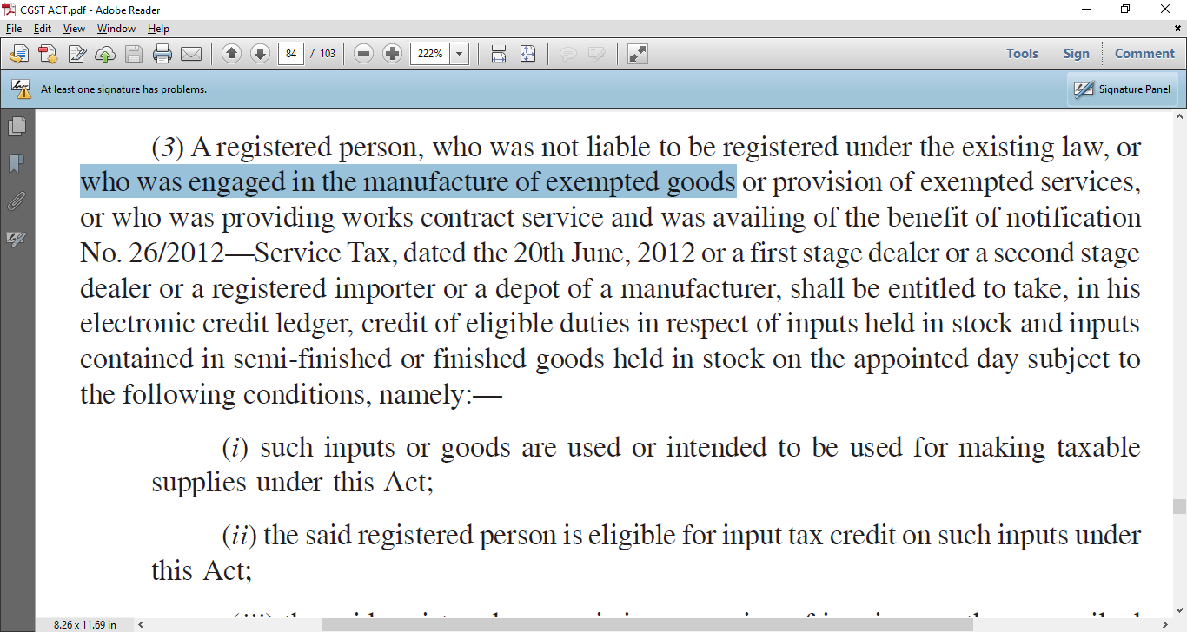
For Depots, Dealers, Exempted goods, 26/2012

Slide 48
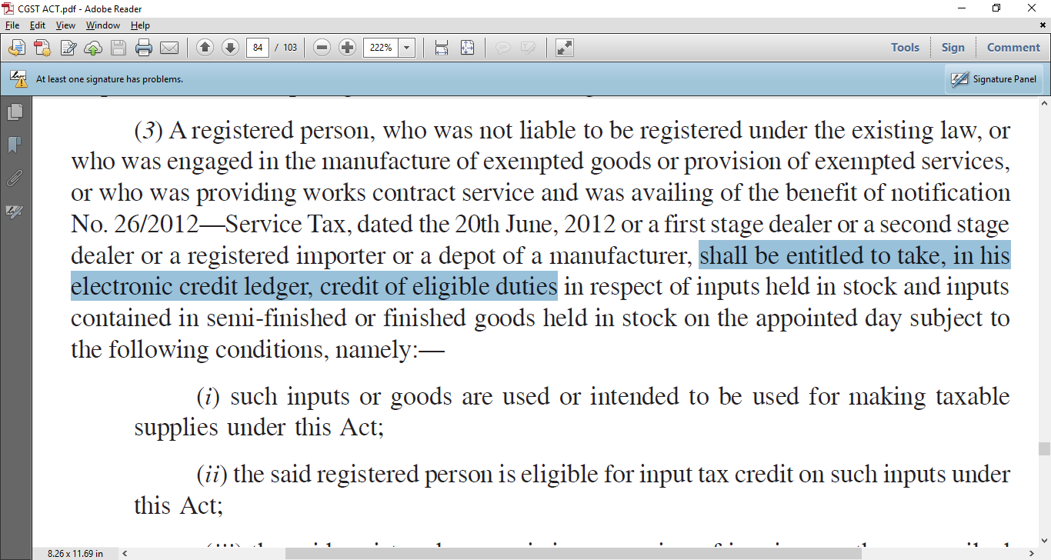
Can take ITC… for all stocks

Slide 49
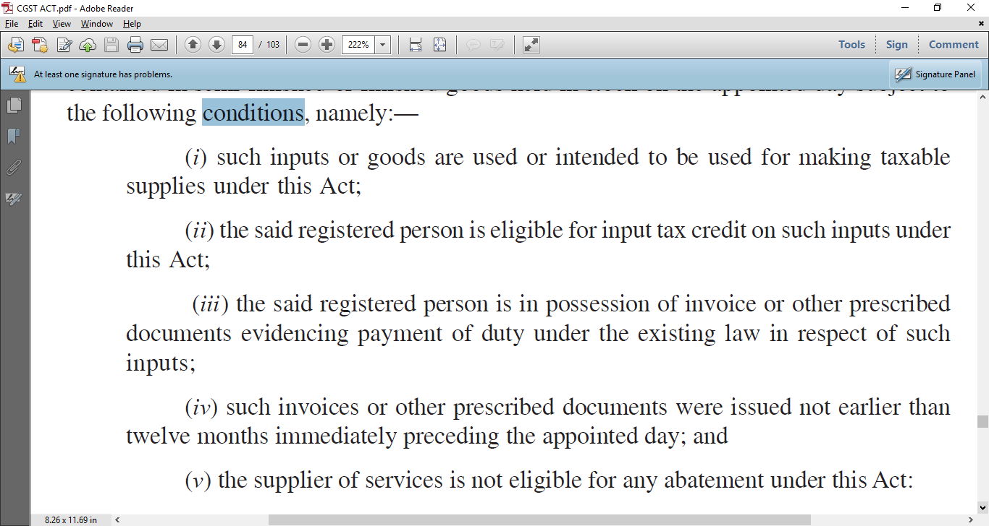
Section 140 :
If you have the Invoices

Slide 50
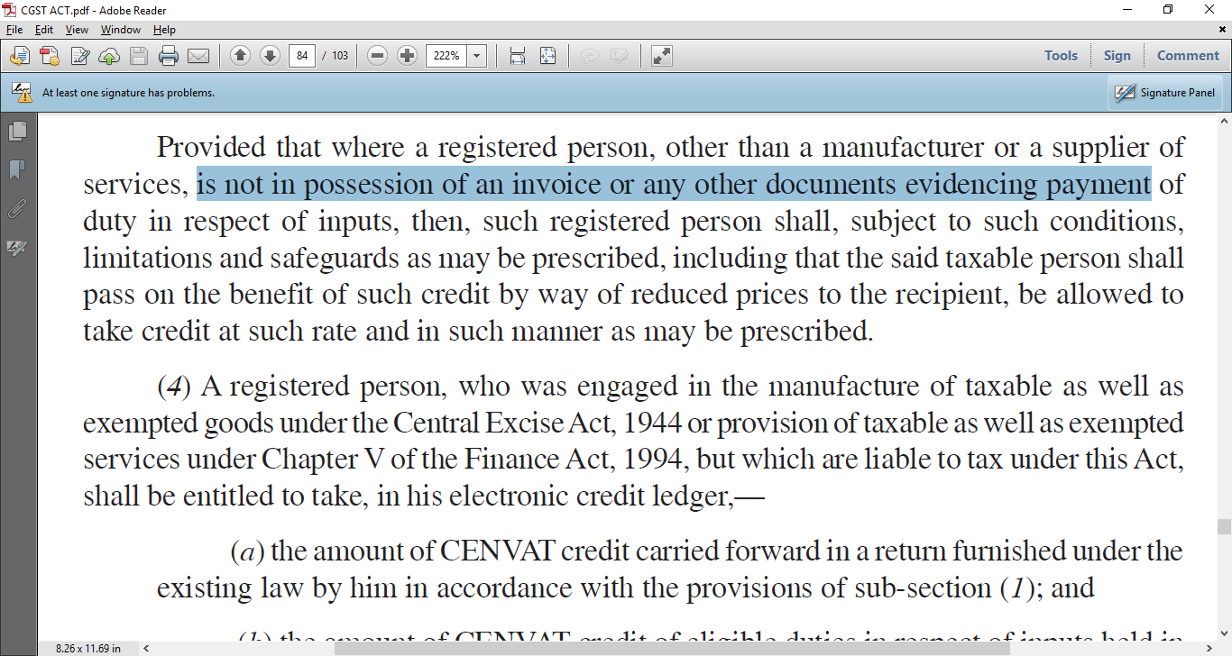
And if they do not have the invoices…Then …”prescribed”..

Slide 51

What are those conditions ?

Slide 52
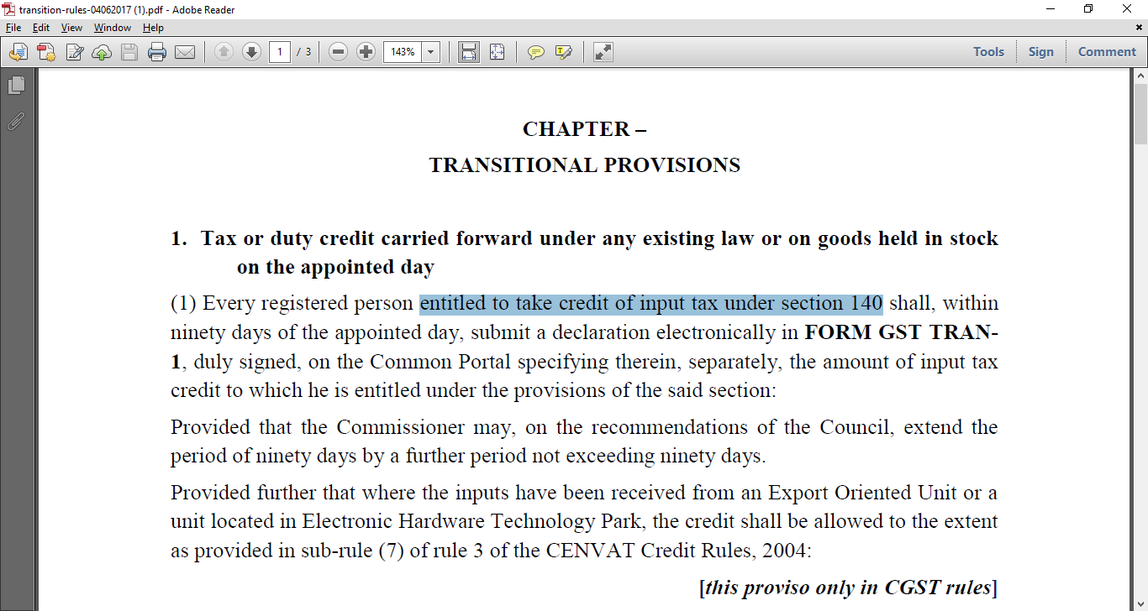
Whatever Modvat you have in books…. Declare please…90 days

Slide 53
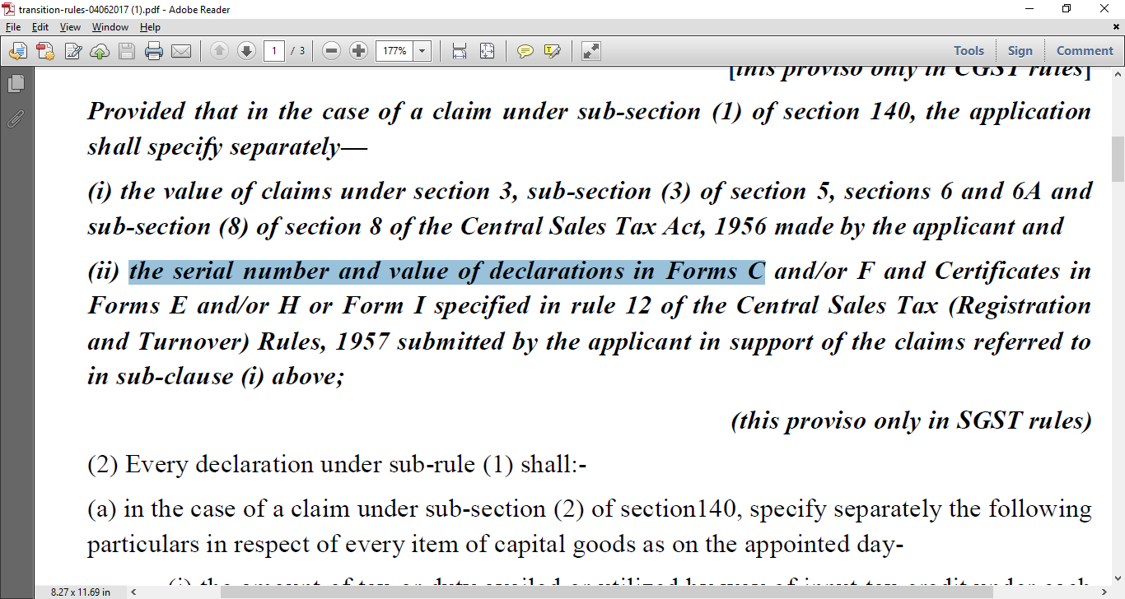
C form Serial Number to be told ?

Slide 54
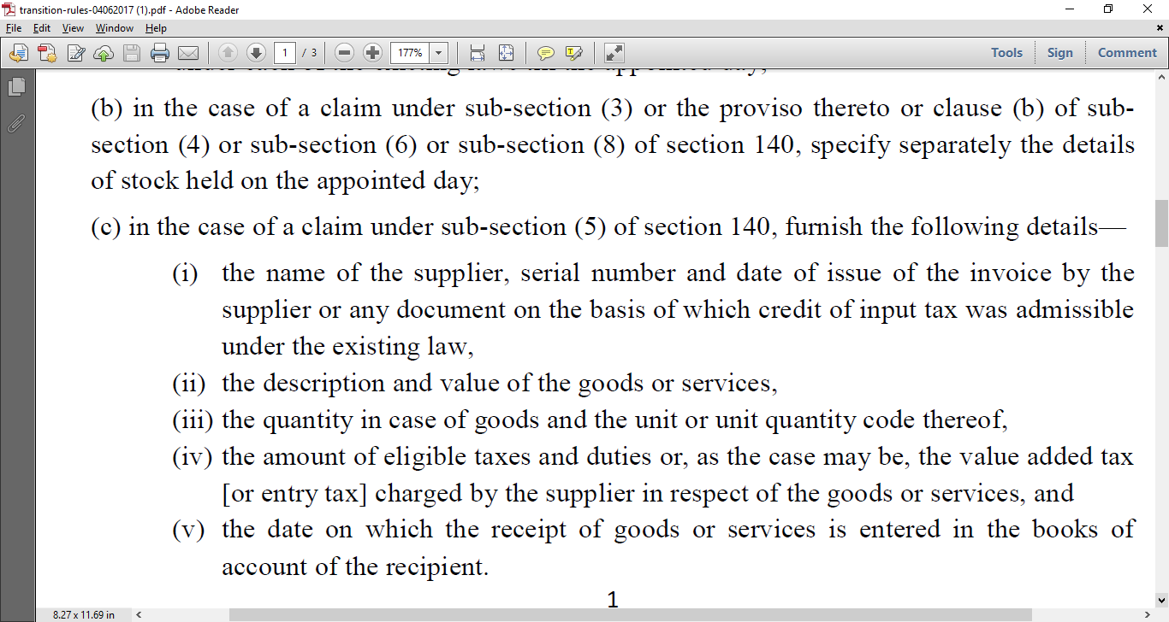
Section 140 : for Stock

Slide 55
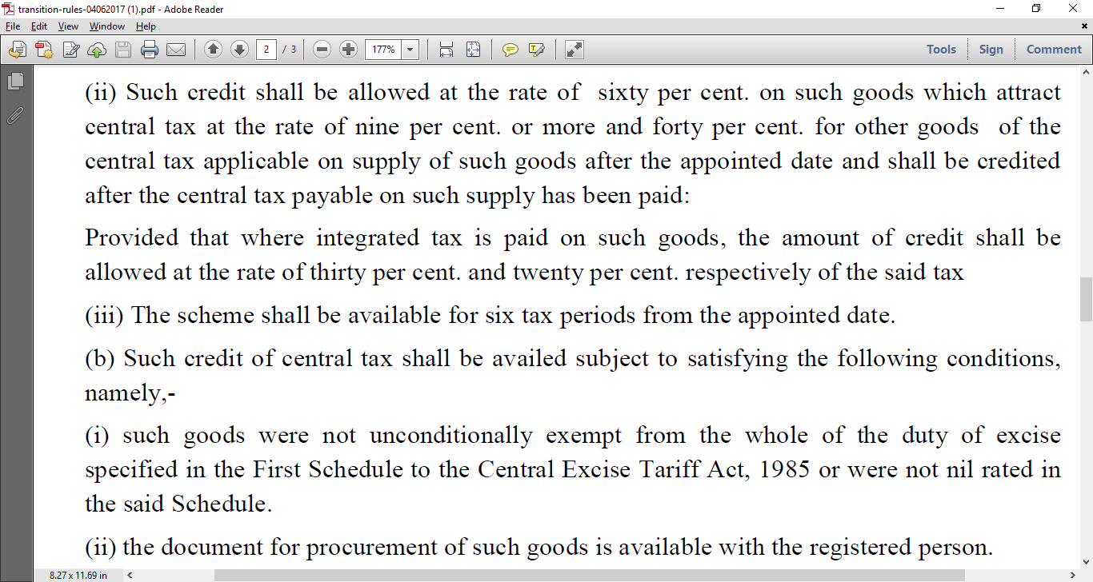
Stock credit 60%..40%

Slide 56
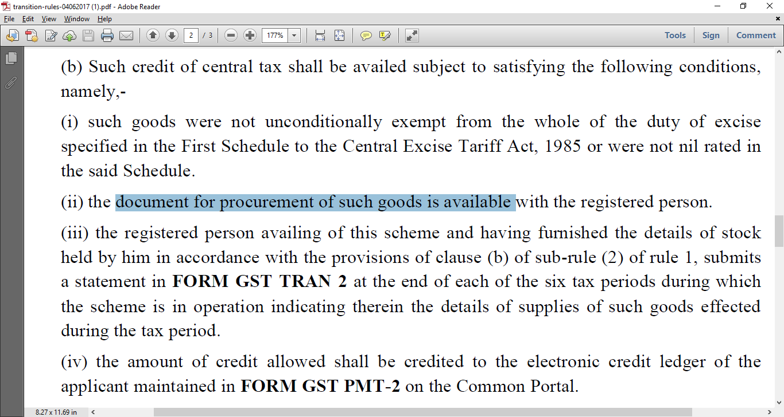
Stock for Himachal/Uttaranchal Clients

Slide 57
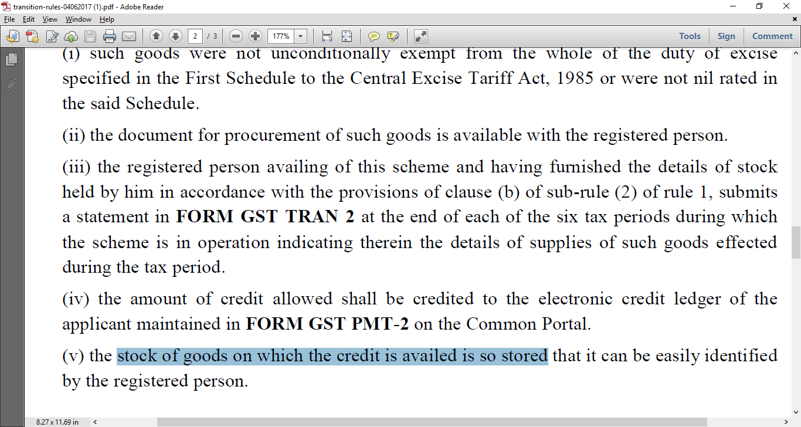
Stock.. Be identifiable

Slide 58
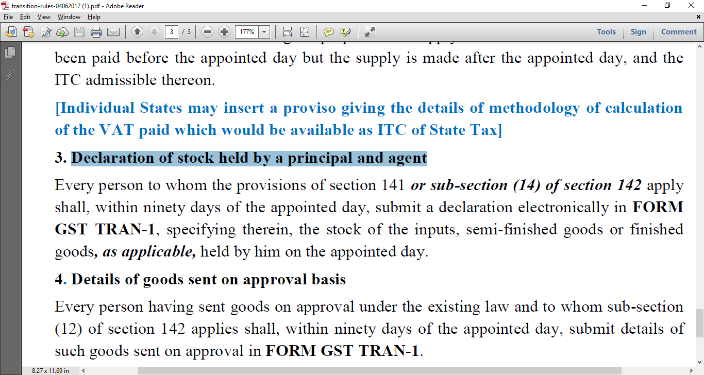
Declare your stock – all Depots

Slide 59

Goods in transit ?

Slide 60
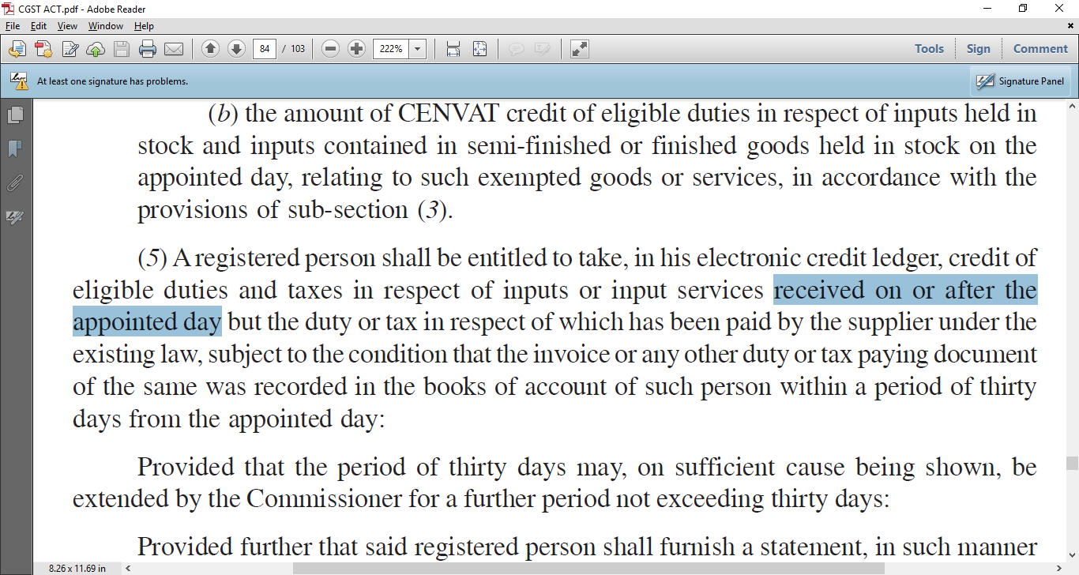
Specific for “Goods in Transit”
PTO

Slide 61
Section 140(5)
(5) A registered person shall be entitled to take, in his electronic credit ledger, credit of eligible duties and taxes
in respect of inputs or
input services ⬅ Note for services too (Auditors bill)
received on or after the appointed day
but the duty or tax in respect of which has been paid by the supplier under the existing law, subject to the condition that
the invoice or any other duty or tax paying document of the same was recorded in the books of account of such person within a period of thirty days from the appointed day:

Slide 62

Job Worker Stock ?

Slide 63
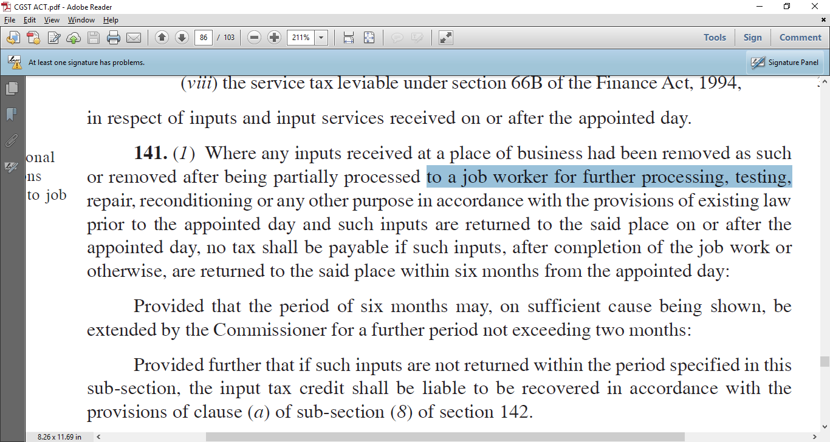
Goods lying at Job worker

Slide 64
Summary
Sent before appointed date
And inputs are returned to the said place after the appointed day,
no tax shall be payable if such inputs,
after completion of the job work or otherwise, are returned to the said place within six months from the appointed day:
31st December 2017

Slide 65
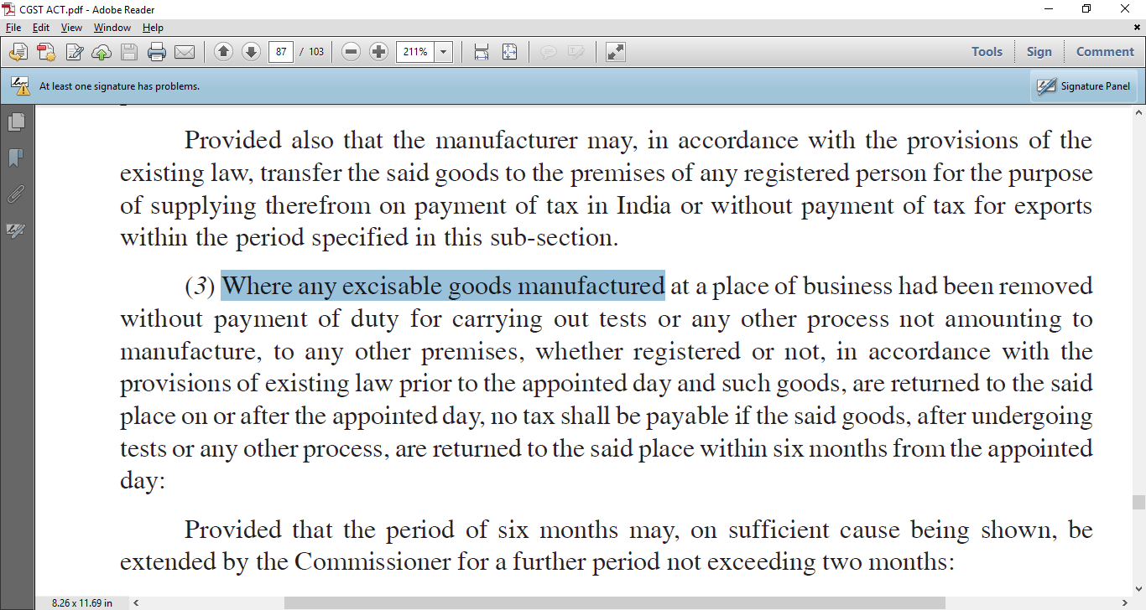
FG sent to another location without Tax

Slide 66
Wait !!
141(4) The tax under sub-sections (1), (2) and (3) shall not be payable,
only if the manufacturer and the job worker declare the details
of the inputs or goods held in stock by the job worker on behalf of the manufacturer on the appointed day in such form and manner and within such time as may be prescribed

Slide 67

Time Limit for Job Work

Slide 68
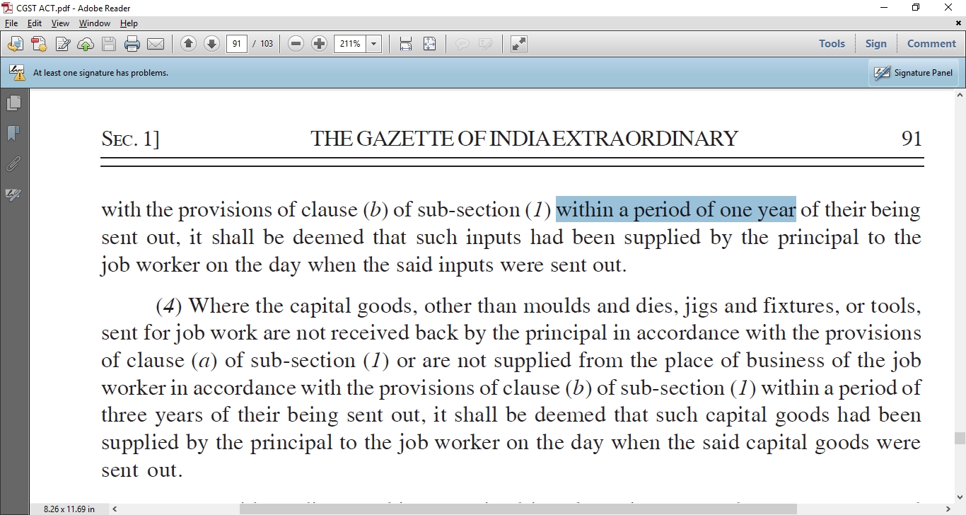
Cap Goods:3 years,
Inputs : 1 year,

Slide 69

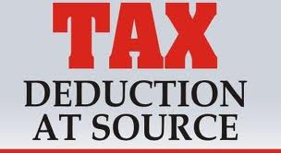
New TDS

Slide 70
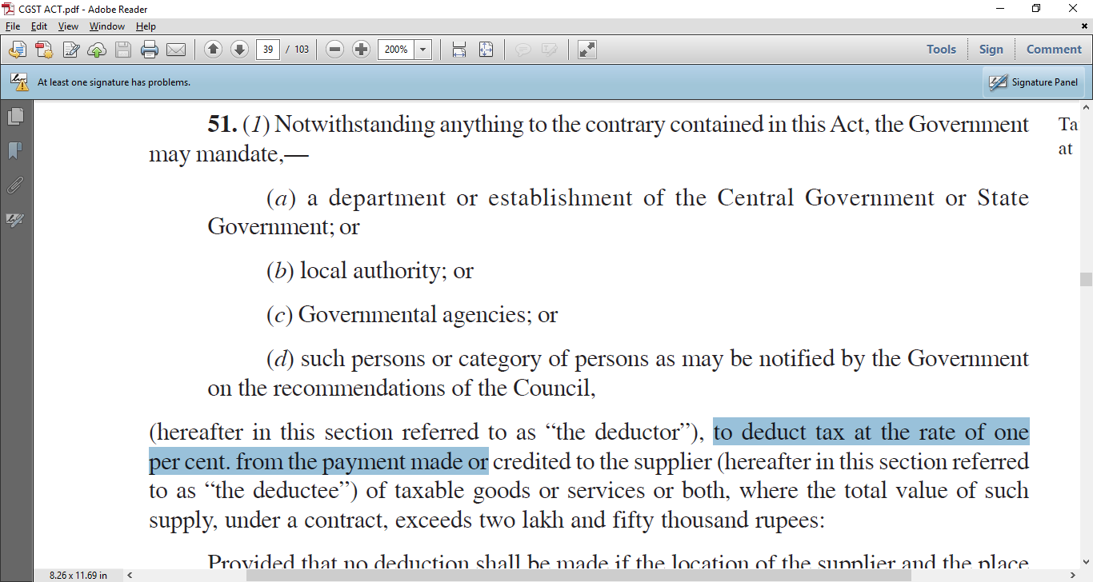
TDS .. 1%...

Slide 71
Time Allowed ?
Time Allowed
10 days from end of month
Only on Local Sales
Within the State
Answer is “Additional work for you”

Slide 72
Penalty….
Time Allowed for TDS certificate : 5 days
5 days from paying to the Govt
If not paid
Rs 100 per day per certificate… upto Rs 5000.
Means 1000 vendors, Rs 1 lakh per day

Slide 74
FAQ # 1 : Goods in Transit ( Future )
Invoice received by courier
But goods not received / Truck in transit / on Rail containers
So,
ITC can be taken ?
Answer is NO

Slide 75
FAQ # 3 : Invoice Scanned copy
Invoice for Services
So,
ITC can be taken ?
Scanned Copy file Received by Email / Photocopy of original bill
Answer is NO …. Except re-do the Original

Slide 76
FAQ # 5 : Vendor does not file return
Invoice for Services
He does not file return
ITC can be taken ?
He does not file return
Invoice for Goods
He does not file return
Answer is NO …. Request him

Slide 77
Solution
Initial
Claim it
Rectify within 2 months
Later, if not
Reverse it, pay with intt

Slide 78

Another Problem

Slide 79
E-way bills
Govt has notified that New Eway bills are being postponed
And Old Eway bills rules will continue

Slide 80
So ?
Old website of say Gujarat, UP, Karnatka, Kerala will not have the new GST number
Karnatka online E-way bill
  Will have the old TIN number only of the customer and vendor
  will not have the GST number of the customer and vendor
Movement of goods as per old EWB rules says invoice must have the TIN of both parties

Slide 81

So the solution is the print old Tin also on the invoices
Both ours and customers
Good Idea !

Slide 82

Next Problem : Rounding off

Slide 83
If you round off the Sales bills
GST portal will calculate and say “not matching”
May create “not-matching” demand
/ “full tax not paid”

Slide 84
If you round off the Purchase bills
GST portal will say “not matching”
May create “not-matching”
Vendor might have uploaded 44500.65
You enter 44500.00
holdups in Reconciliations

Slide 85
So, the idea is
Let all 3 ERP’s handle this automatically.
Upto 2 decimal places as is standard in India.
Good Idea !

Slide 86



Finsys and Webtel… Together in propelling your Growth

