Slide 1



Getting Ready for the “Big Change”
Our Learnings from the GST :
How Finsys-Webtel combine seeks to Make Transition to GST Smooth & Effortless

Slide 2

Mr Sangeet Kr Gupta
FCA , FCMA, DISA, B.Com(Hons), PDGMM : Finsys Infotech Limited
Email : SKGupta [at] finsys.in
Academically, All India First Rank, in DISA course by ICAI.
Awarded Gold Medal by the Haryana Government
Honorary Consultant and regular speaker at Industrial Forums and Professional Bodies / Associations.

Slide 3
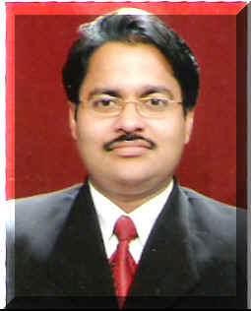
Mr Puneet Kr Gupta
FCA , PDGMM, PGDCA, B.Com(Hons)
Finsys Infotech Limited
Email : PKGupta [at] finsys.in
Technical Brain behind the Finsys Universe
Eminent Chartered Accountant
regular contributory and speaker on various topics related to best usage of information technology and data handling for achievement of business excellence

Slide 4

Goal of this GST Conclave ?

Slide 5

Goal is “Smoother Transition”

Slide 6
We will not focus
on merely ”Theory”
We shall not focus on “section number”
We shall not focus on Long difficult section clauses
We will not focus on General knowledge
We will avoid the “Grey Areas”
Together, all will avoid taking political sides.
We will focus on what is in front of us and create solutions out of that.

Slide 7

We focus on Quick and Smooth “Transition”

Slide 8
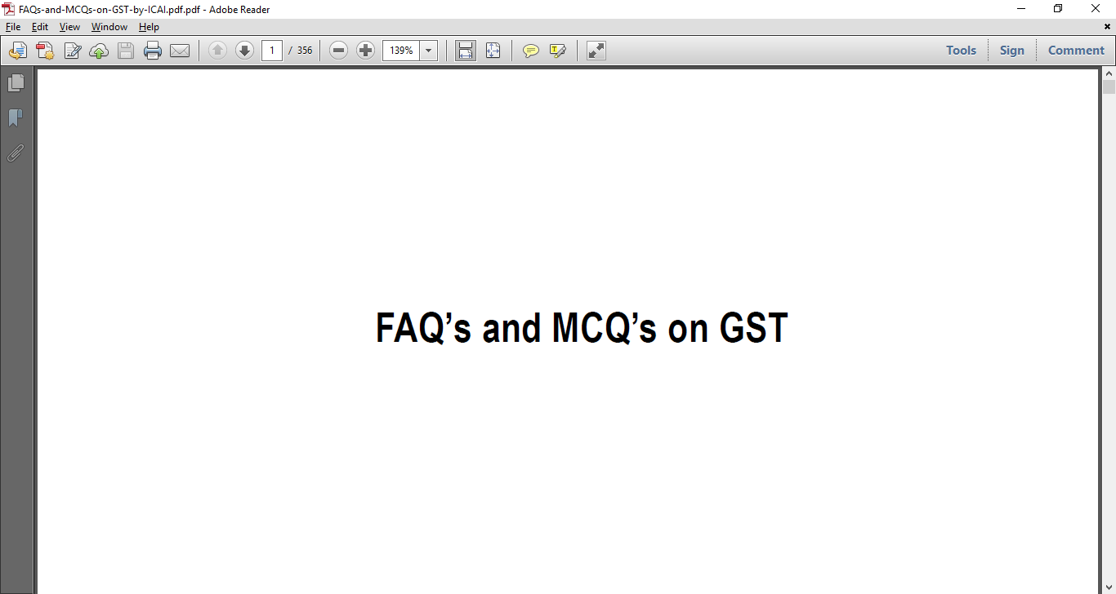
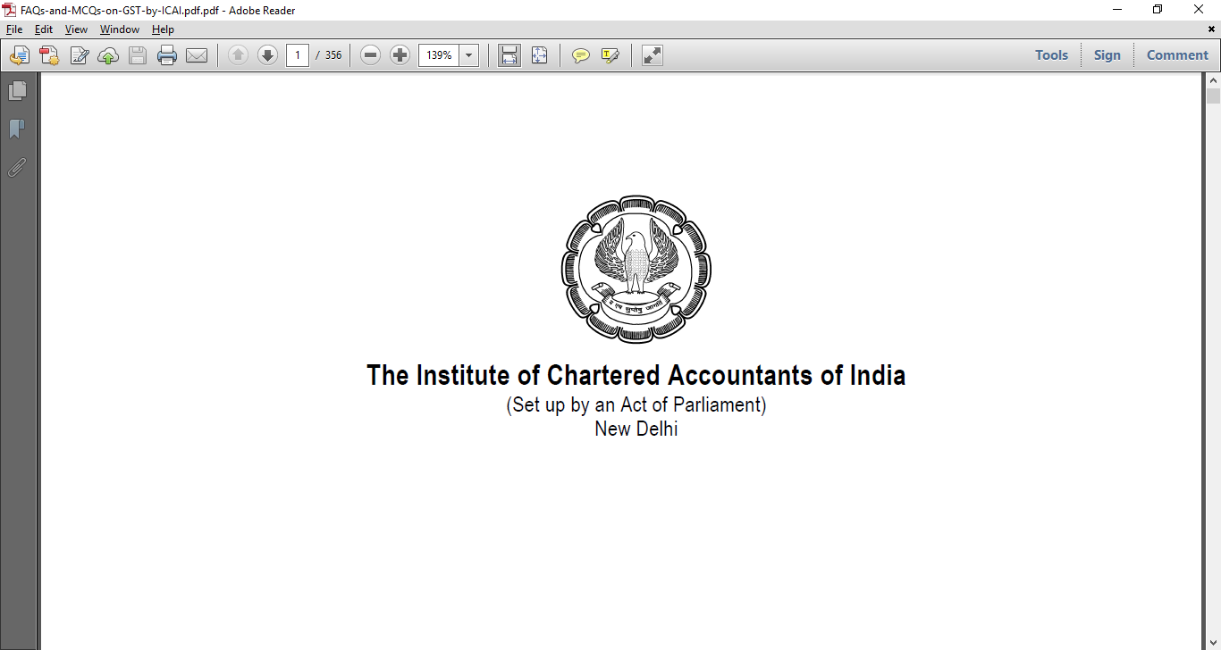
Our inputs include

Slide 9
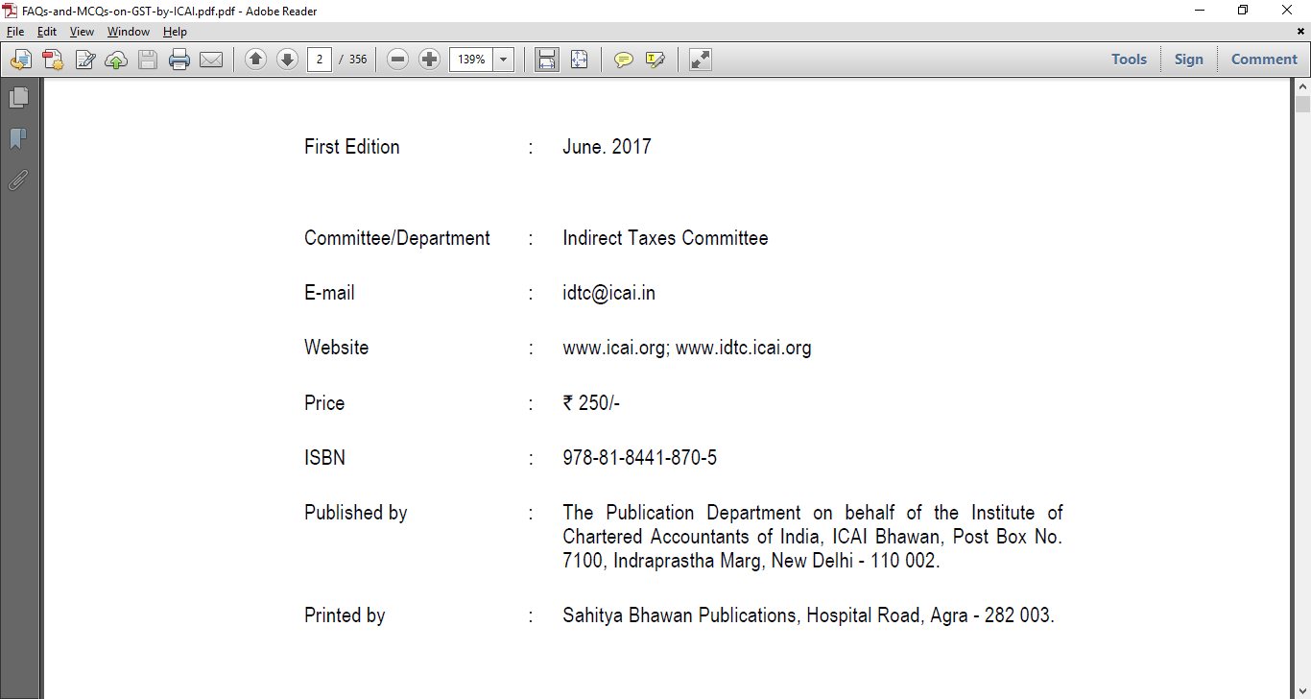
Released just first week of June 17

Slide 10
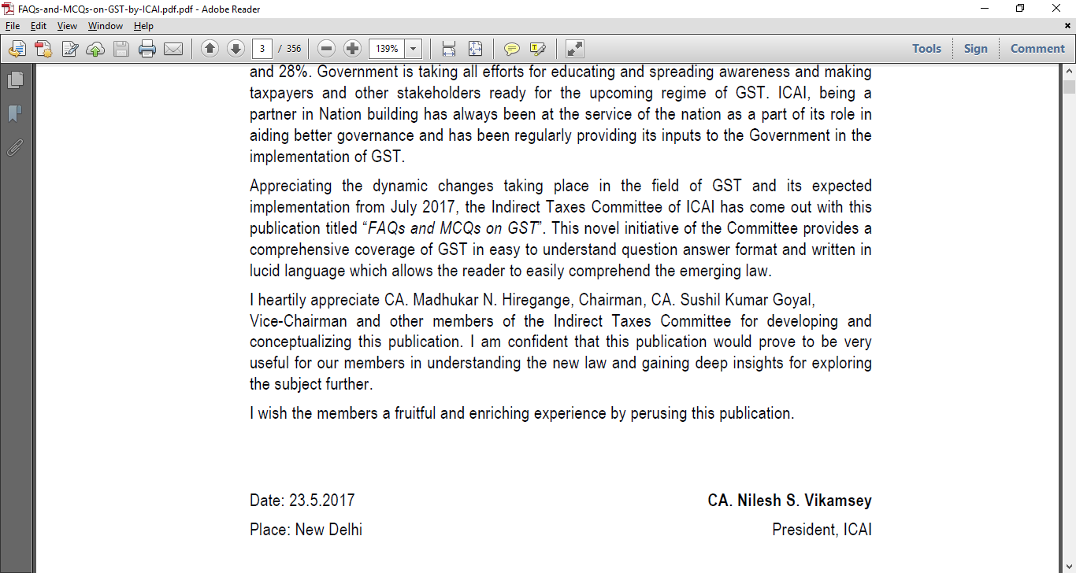
Finalised last week of May 17

Slide 11
Our Focus today
What to do immediately ?
Manufacturers
What to remember ?
How Finsys-Webtel combine will help
Take Decisions, Take Action
Results : Clearer Planning+Action+Transistion

Slide 12



An important Message
This Forum is for Solving, and for Sharing
If you have a Query, please note it down, we take it off line

Slide 13

FAQ Time ?
We will be focussing on FAQ today during our discussions.
Further, We welcome your Questions.
Do write down and do ask
However at the end of the session, 30 minutes only for FAQ
More time, if required

Slide 14
First Point to Remember
(for your Staff)
In the GST regime, The Taxation rule is as under
Inter State Sale
  If the Home state is Haryana,
  Customer state/shipping location is Maharashtra
  Then we charge IGST only
Local “within State Sale”
  If the Home state is Haryana,
  Customer state/shipping location is also Haryana
  Then we charge combination of CGST + SGST
FYI The Purchases are also on similar lines
All this has already been configured in the Finsys (active wef 1-7-17)

Slide 15

Our Target
Proper GST invoicing from 1st July 2017.
Proper “Buying” from 1st July 2017.
Proper “Accounts” from 1st July 2017.

Slide 16
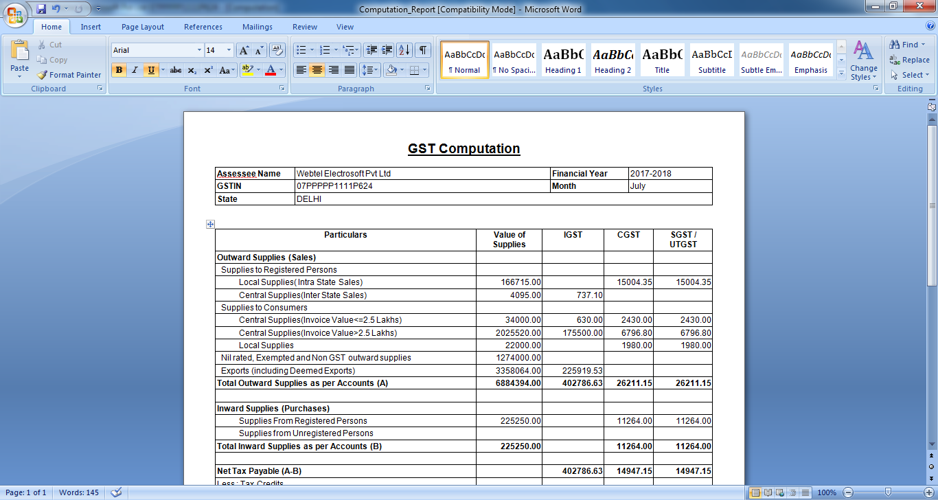
Example of End Result : GST Computations in Webtel

Slide 17
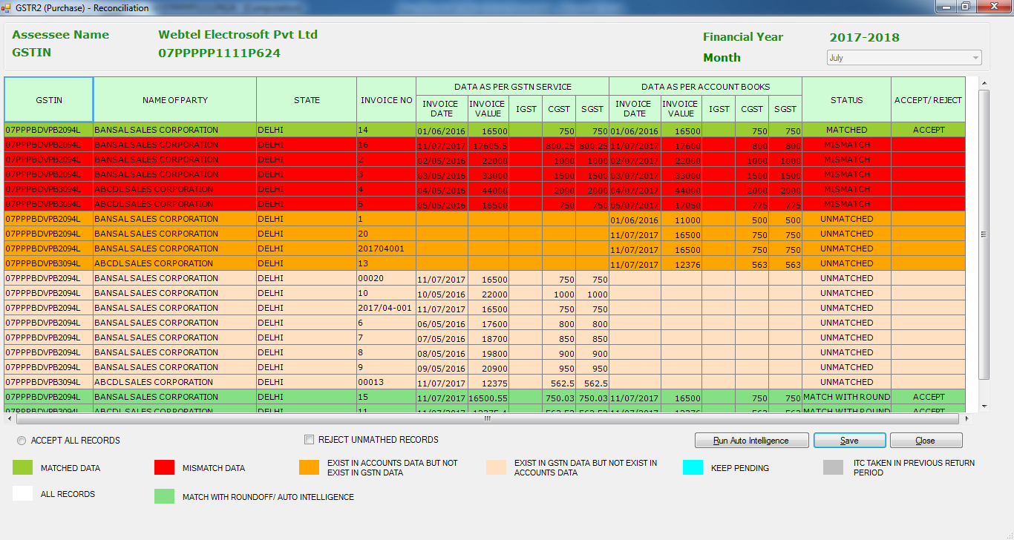
Bill Reconciliations
Red : Mismatched / Green : OK

Slide 18
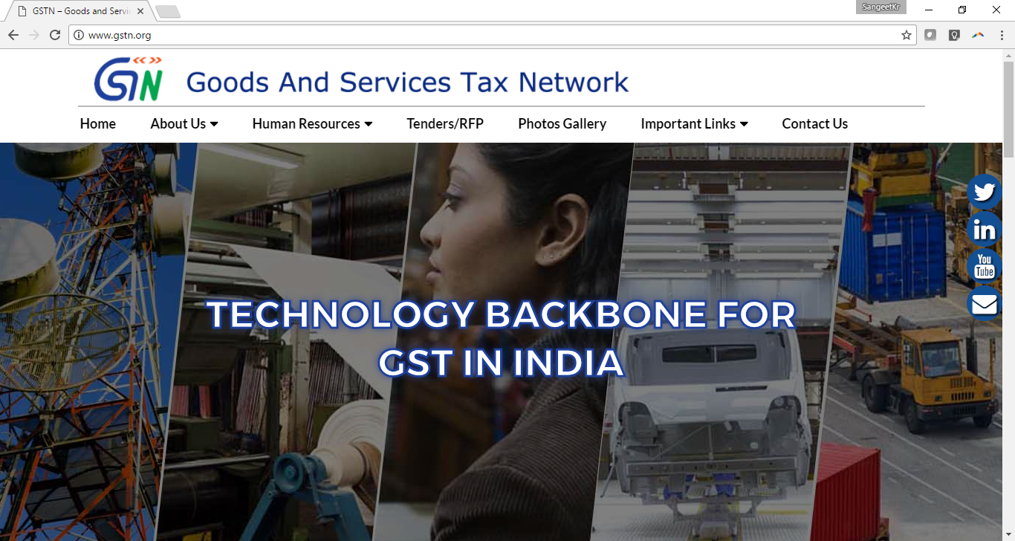
GST Portal : official

Slide 19
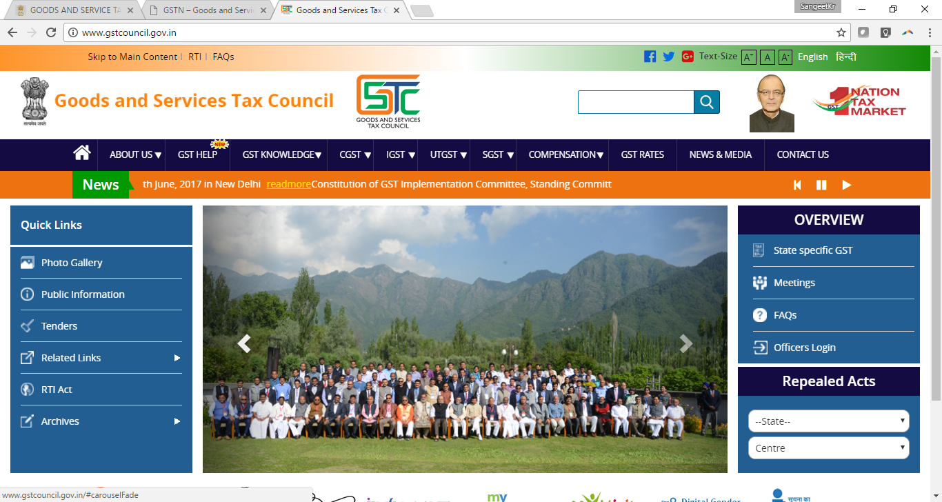
GST Council…. the backbone

Slide 20
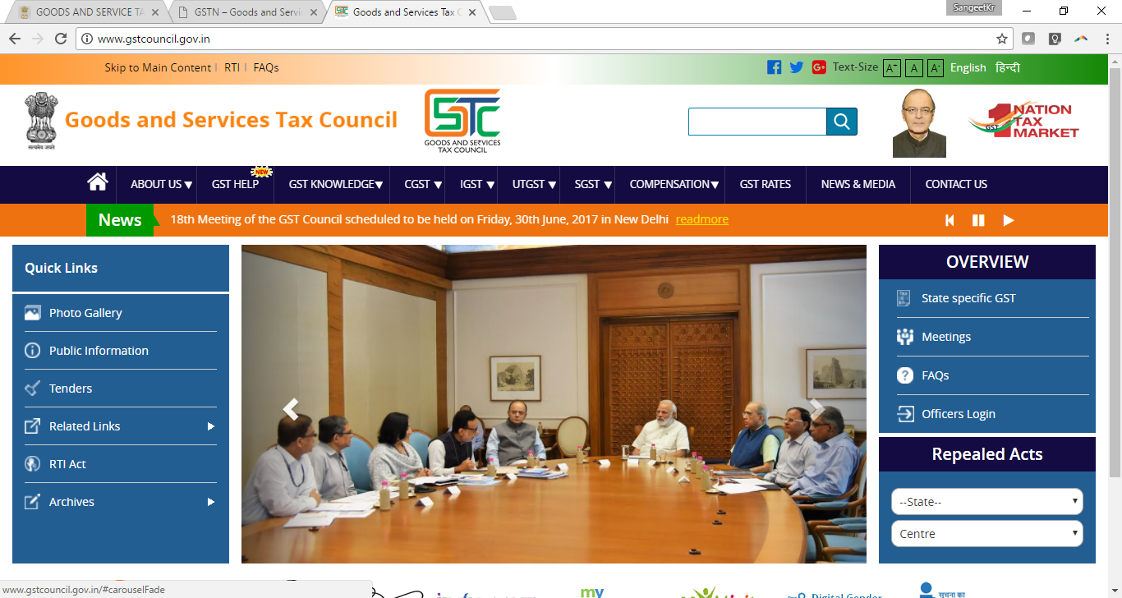
Mr Modi at one of the Meetings

Slide 21

Come, lets Start

Slide 22

Finsys and Webtel… Together in propelling your Growth

